Slide 1
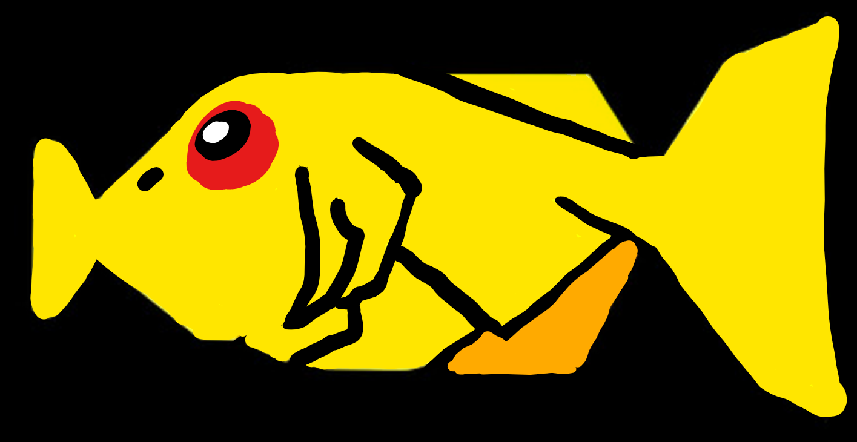
Sentiment Analysis
#IndiaMLMeet
Ilia Karmanov
Microsoft ADS - London
Machine Learning & Data Sciences Conference | Aug 8-9, 2016 | Bangalore

Slide 2
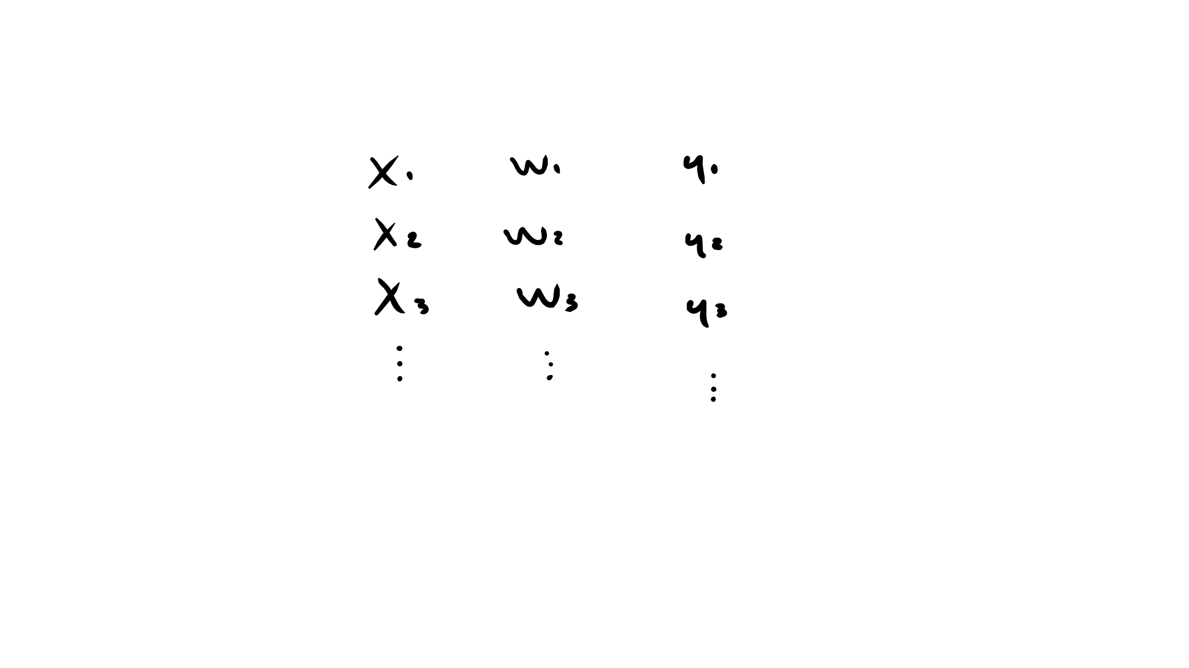
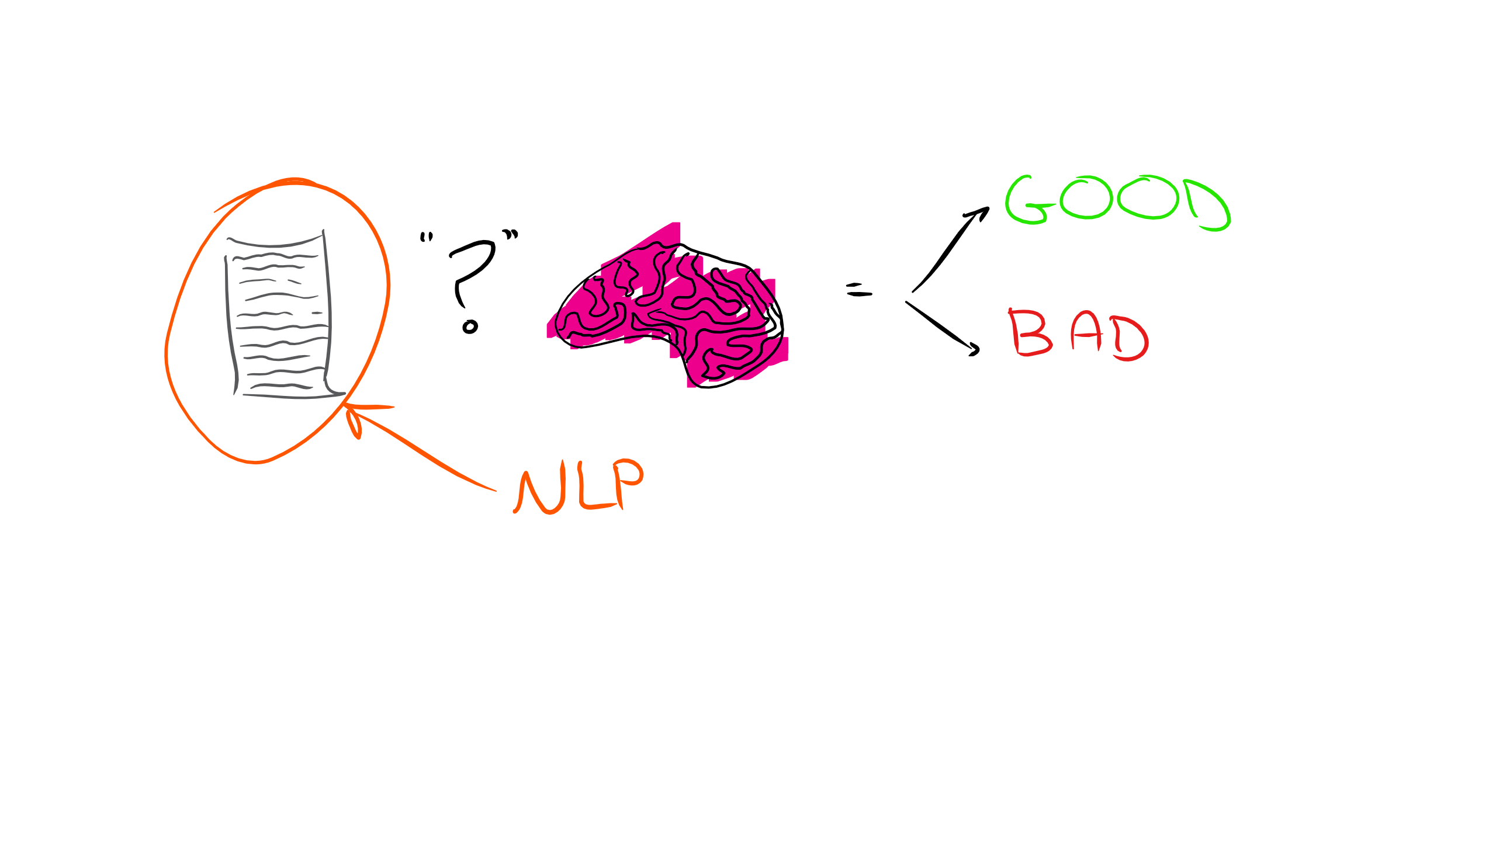
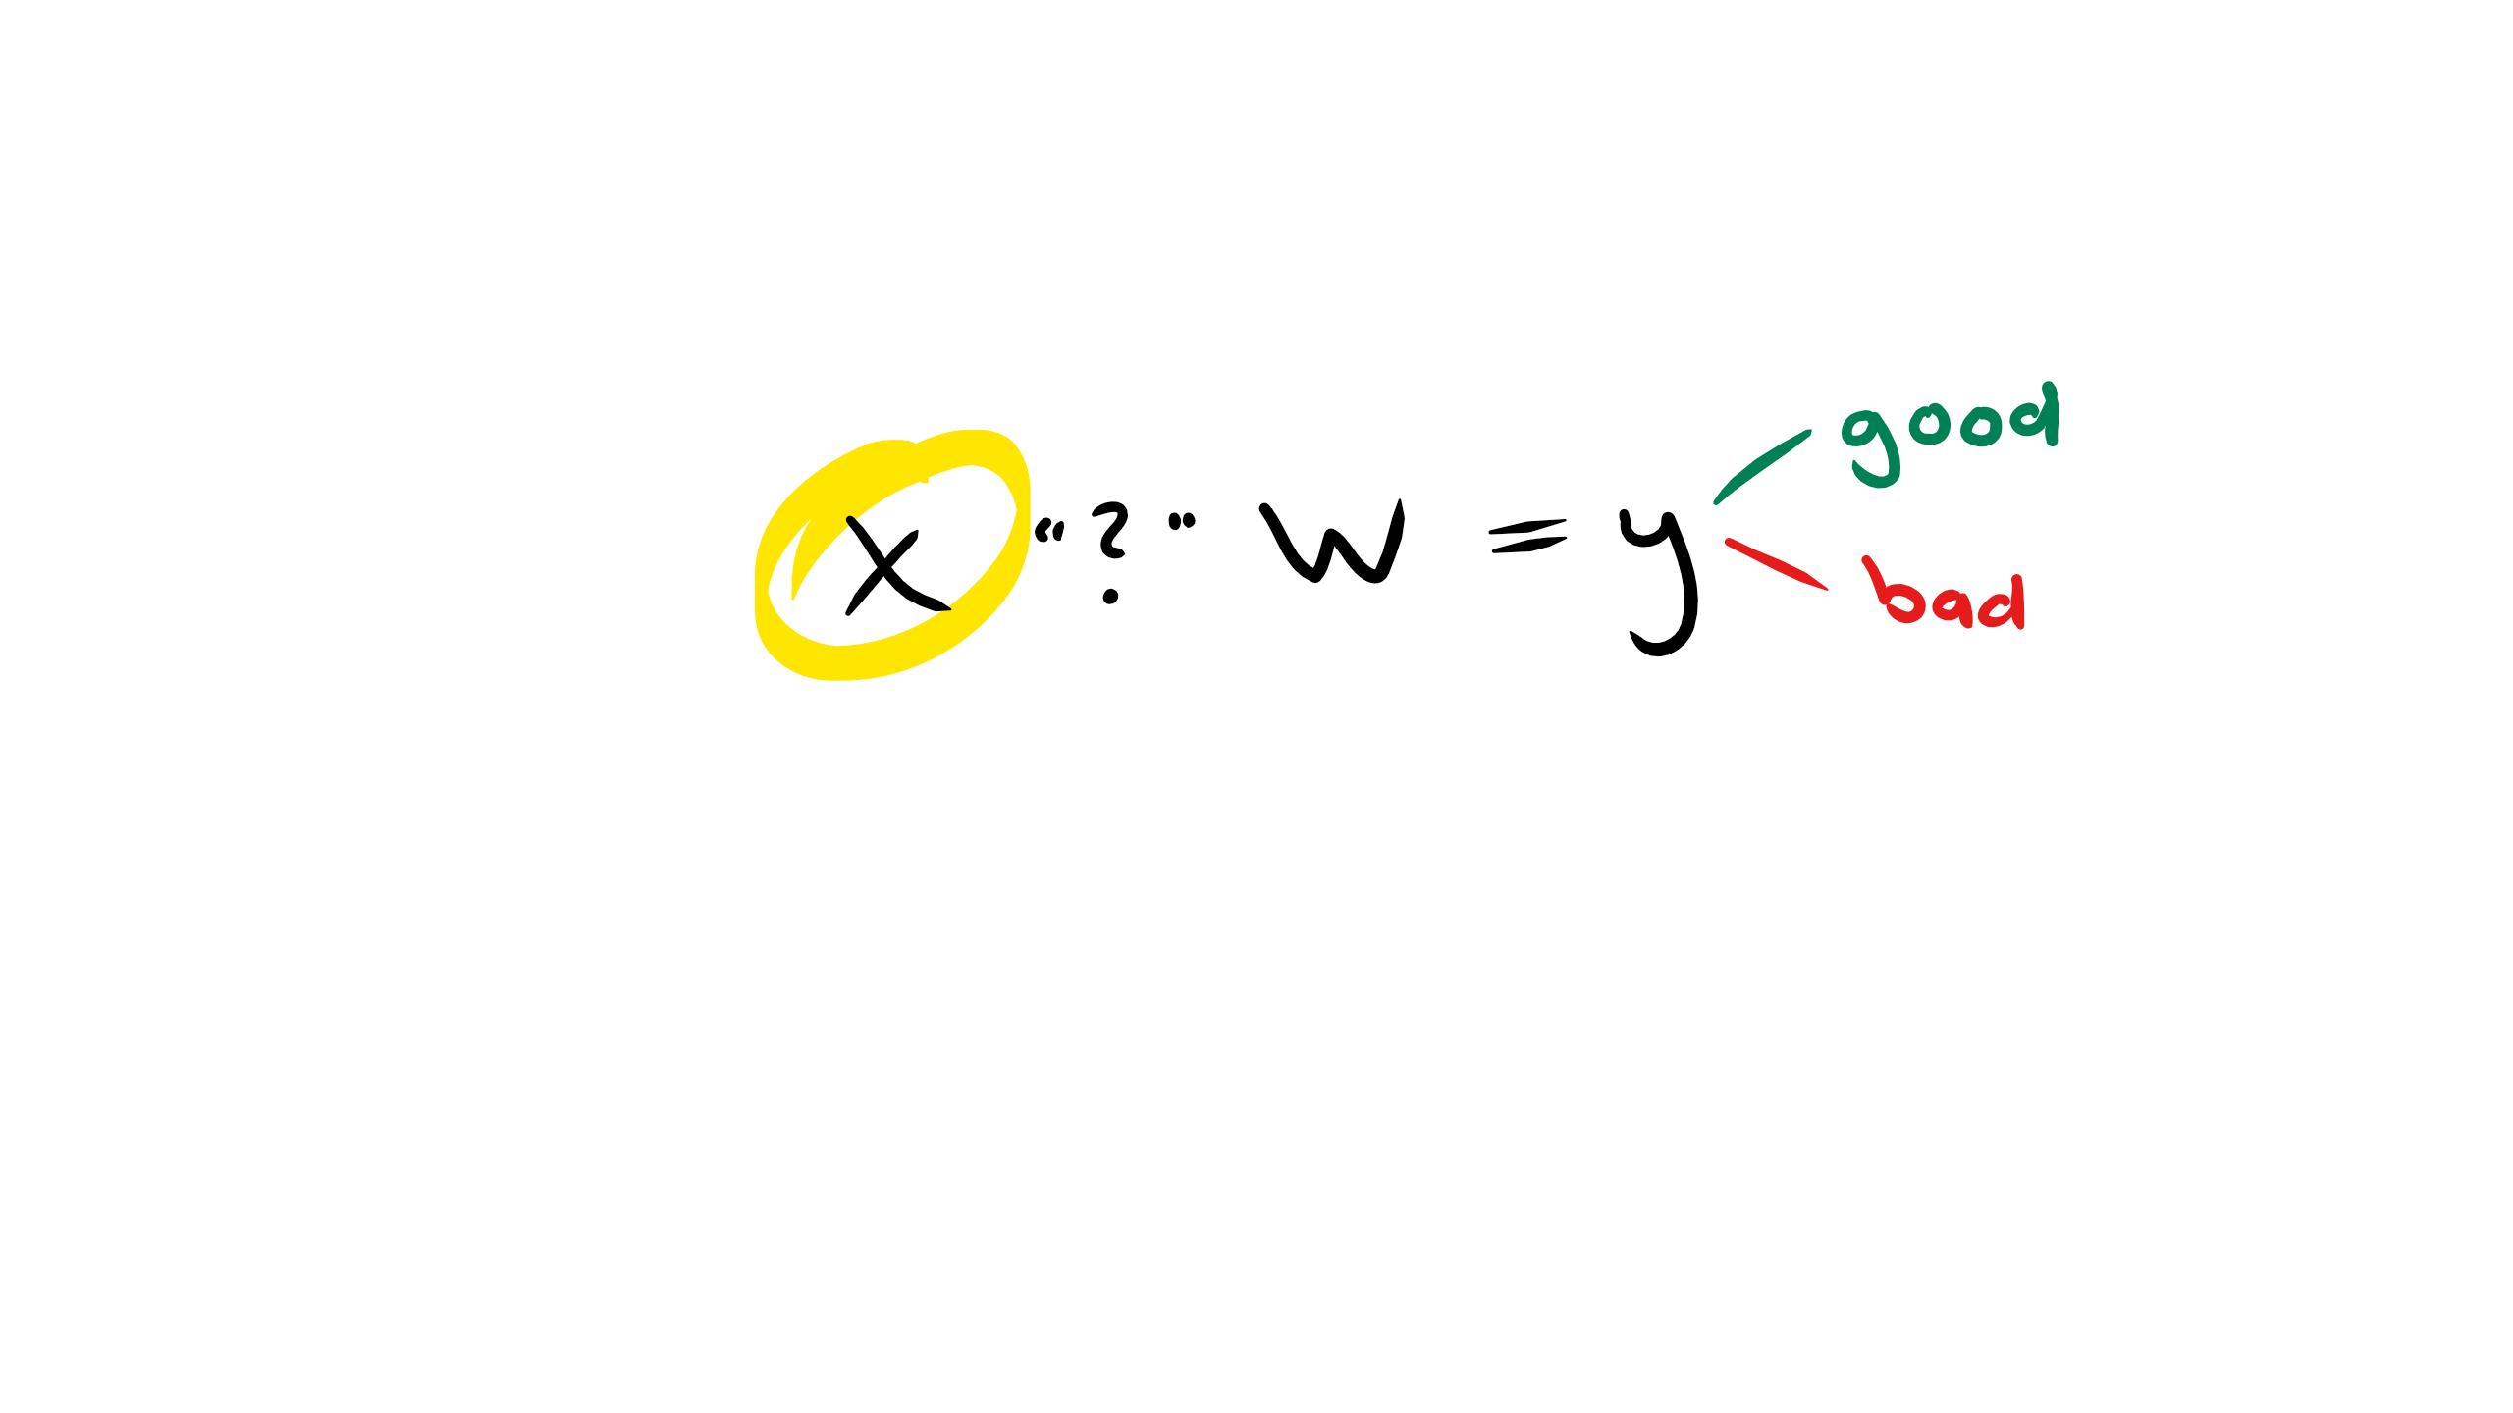
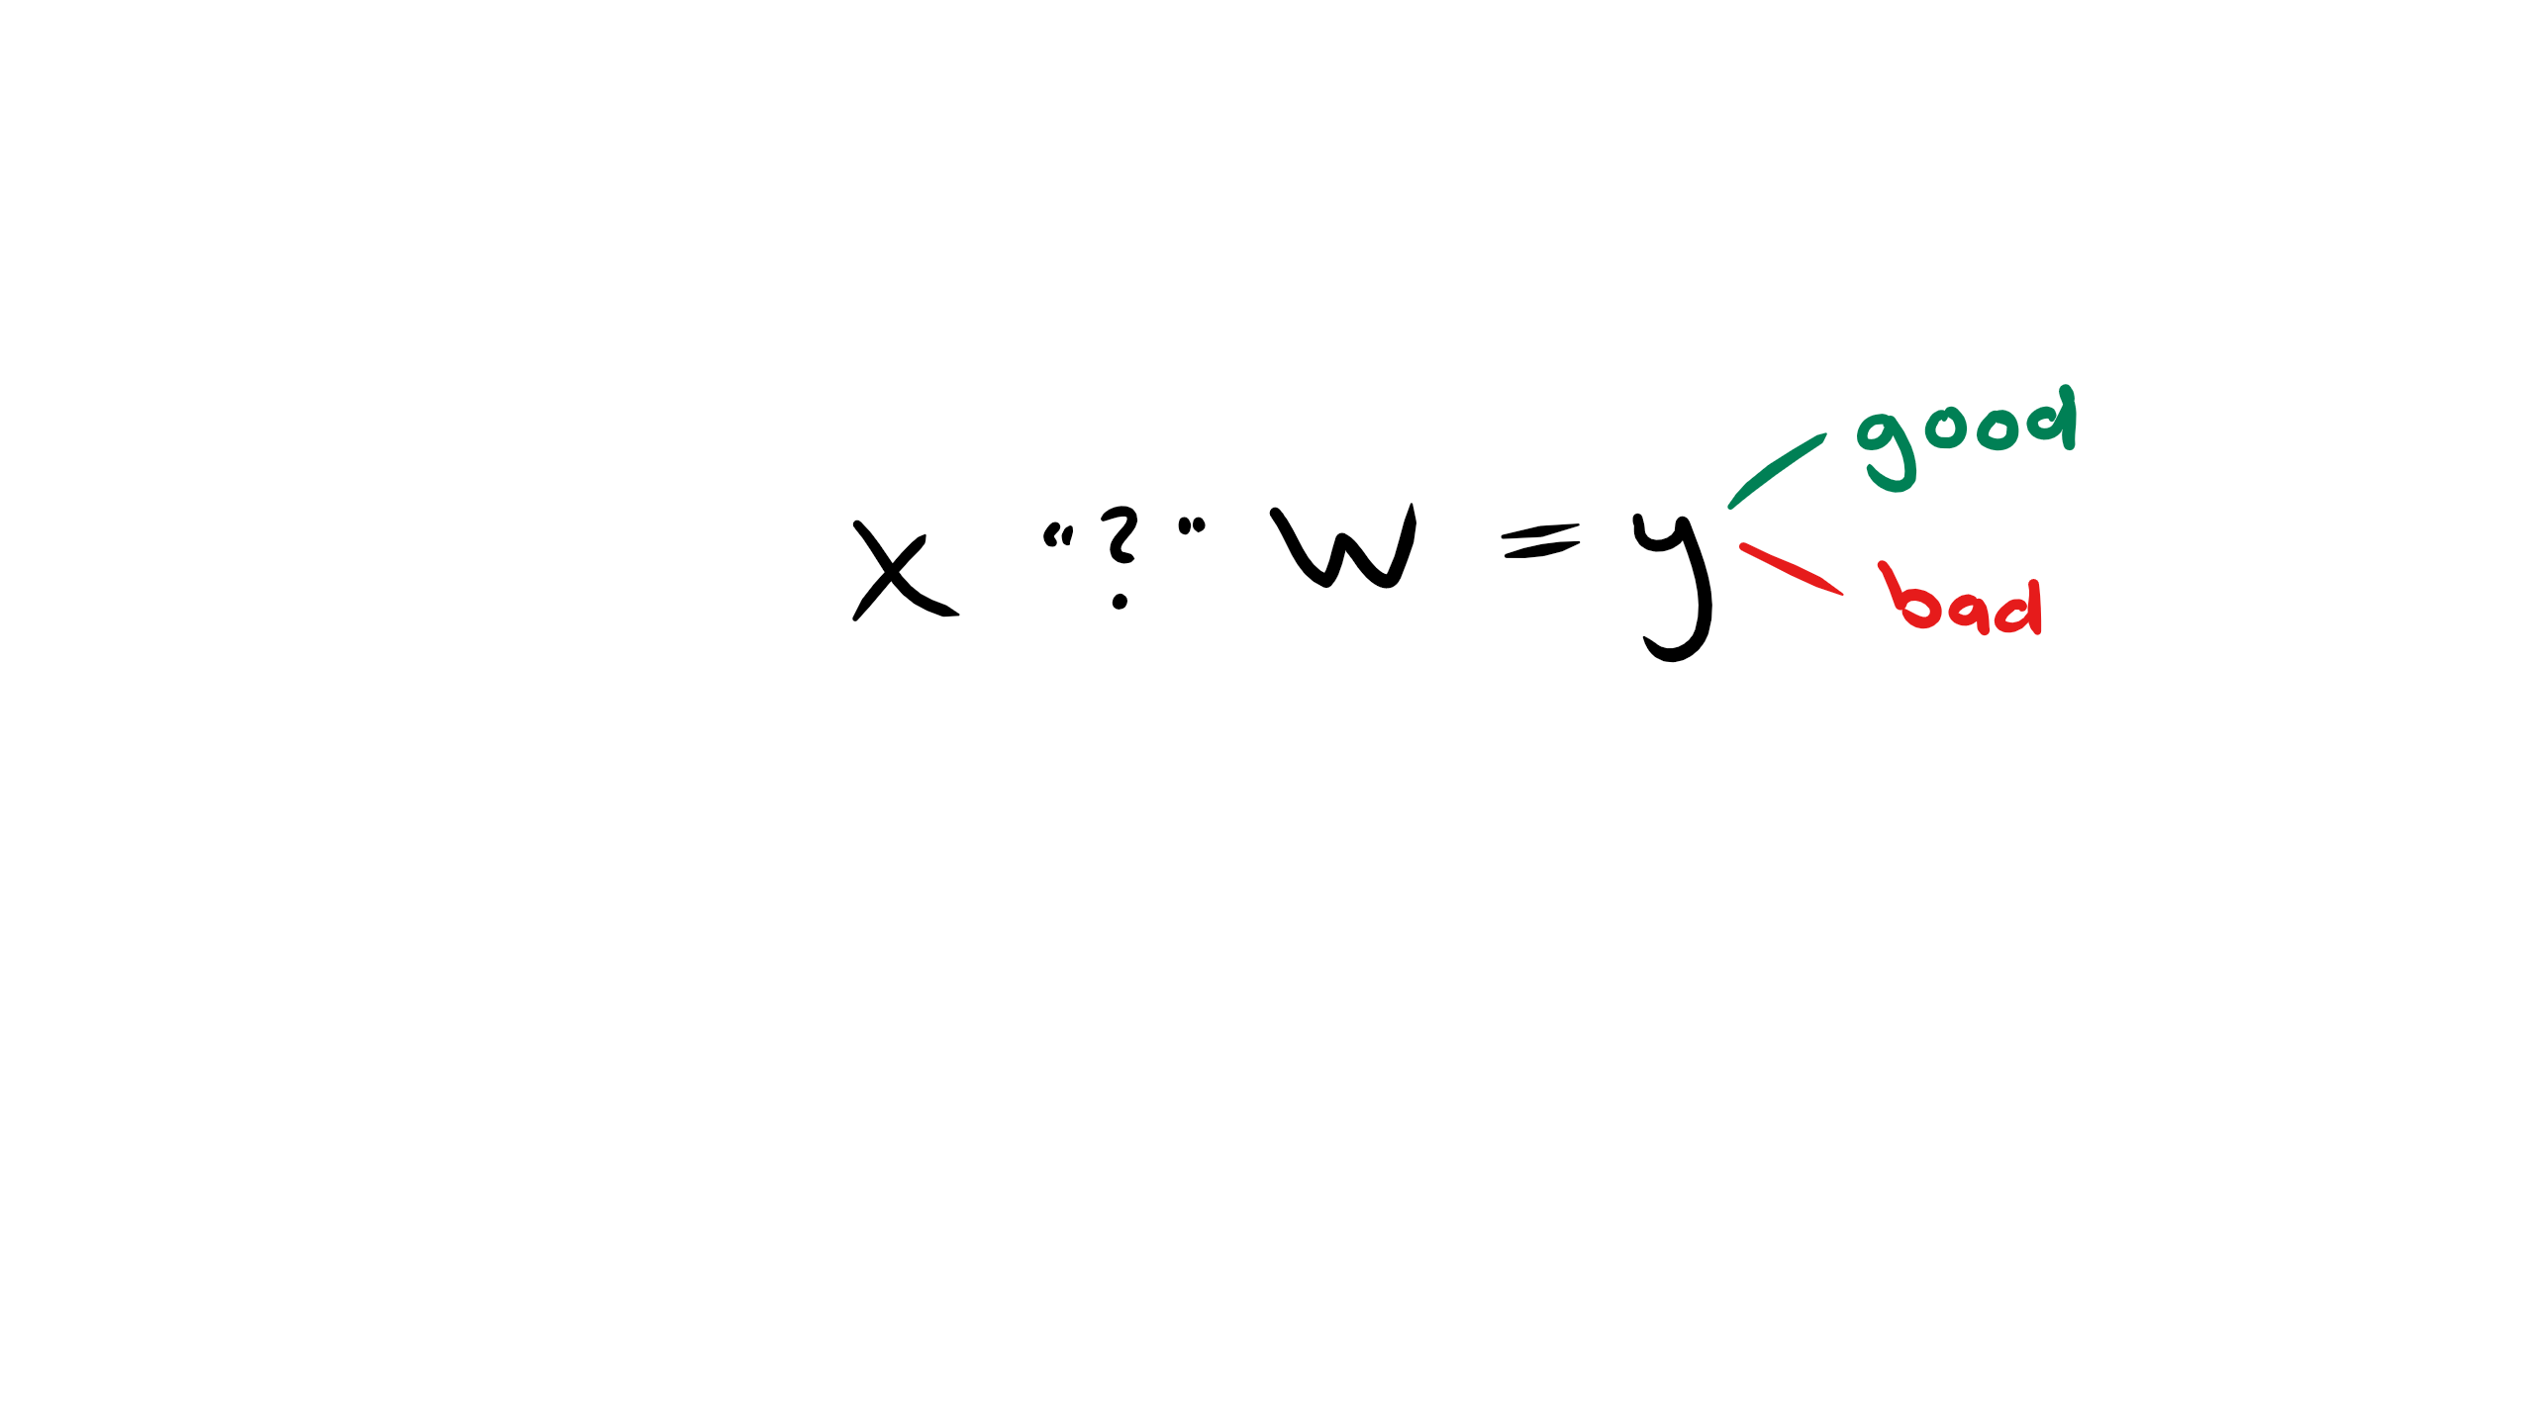
Sentiment Analysis
Classification: decide whether text has a positive or negative meaning
Supervised learning

Slide 3
Sentiment Analysis
Most methods focus on the “brain” of the model
Here we will examine how to represent text as the “input”
Creating representations of text is core to the field of Natural Language Processing
How do we feed variable length documents into a computer model?
We will move beyond words as atomic symbols

Slide 4
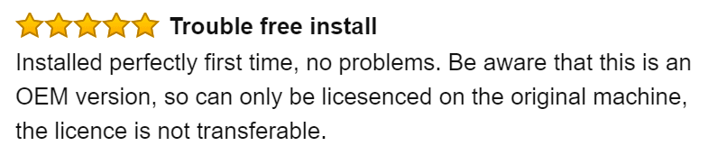
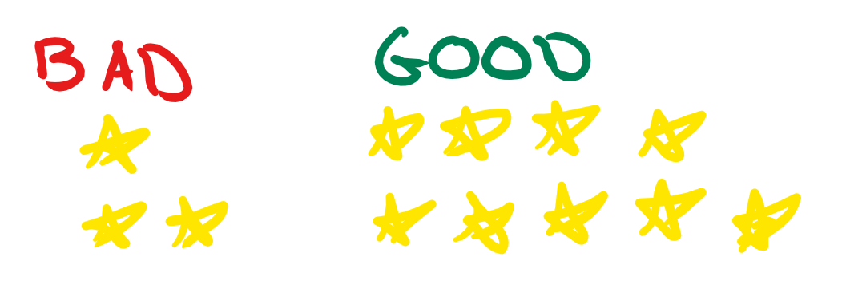
Sentiment Analysis
The backend to this presentation: https://github.com/ilkarman/Bangalore_Sentiment/
I will be working with a data-set containing more than 80 million Amazon reviews

Slide 5
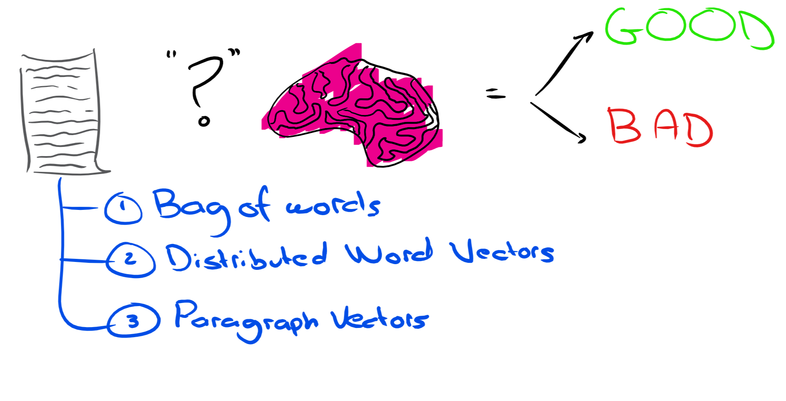
Contents
We will cover three different ways of presenting “X”:
We will examine the effect on real-world data
We will walk through an application using Microsoft HDInsight

Slide 6
1. Basic Approach – Bag of Words

Slide 7
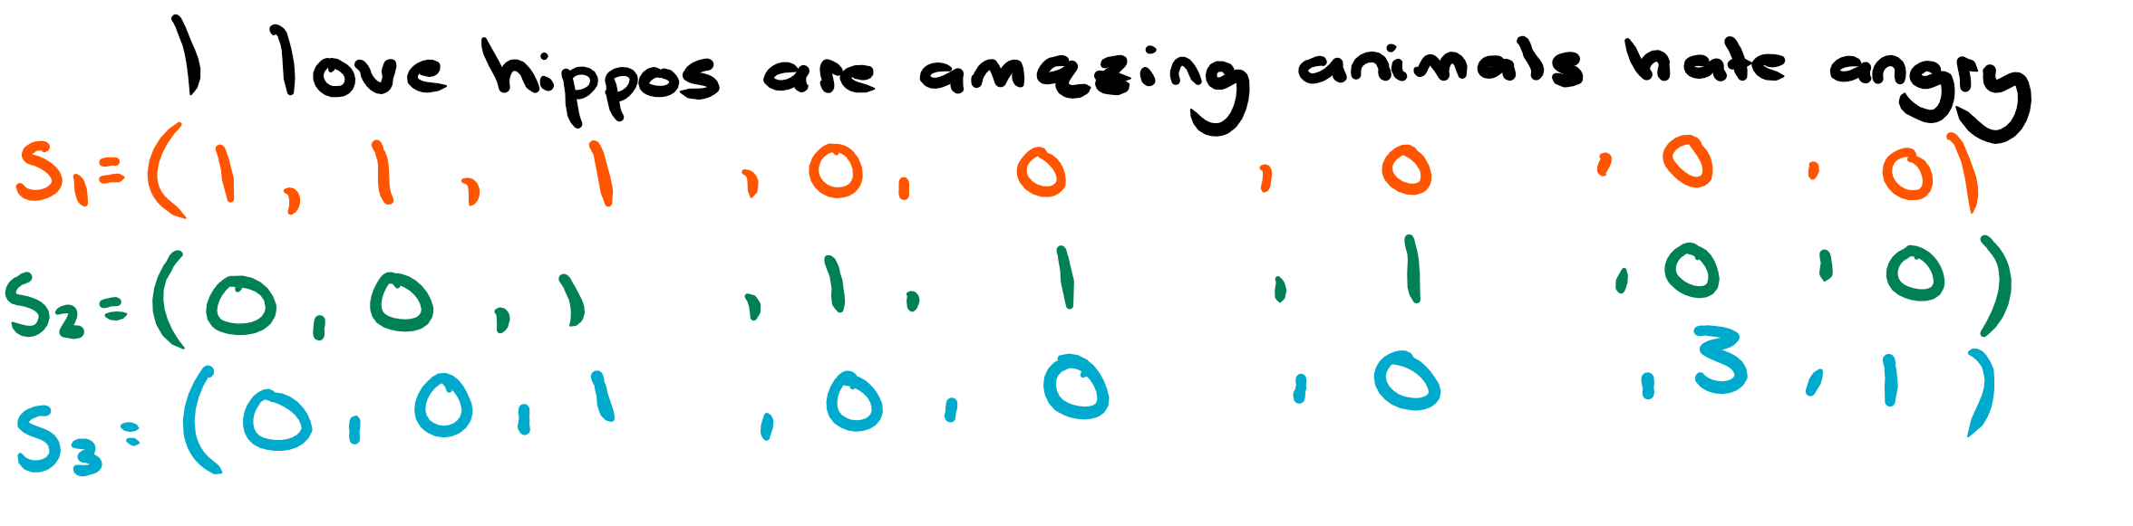
Bag of Words Approach
“I love hippos”
“Hippos are amazing animals”
“Hate hate hate angry hippos”

Slide 8
Bag of Words
Term Frequency (divide by word count):
S1 = (1/3,1/3, 1/3, 0, 0, 0, 0, 0)
S2 = (0, 0, 1/4, 1/4, 1/4, 1/4, 0, 0)
S3 = (0, 0, 1/5, 0, 0, 0, 3/5, 1/5)
“Hippos” is in all three of our reviews
Are all terms really equally important?
Weights: less emphasis on common words and more on rare ones

Slide 9
Bag of Words
Inverse Document Frequency:
# of documents divided by the # of documents containing term
Tfidf(t,d,D) = tf(t,d) x idf(t,D)
Where; t = term, d = document, D = corpus
The idf for “hippos” = ln(3/3) = 0
It carries no weight in our sentiment classification

Slide 10
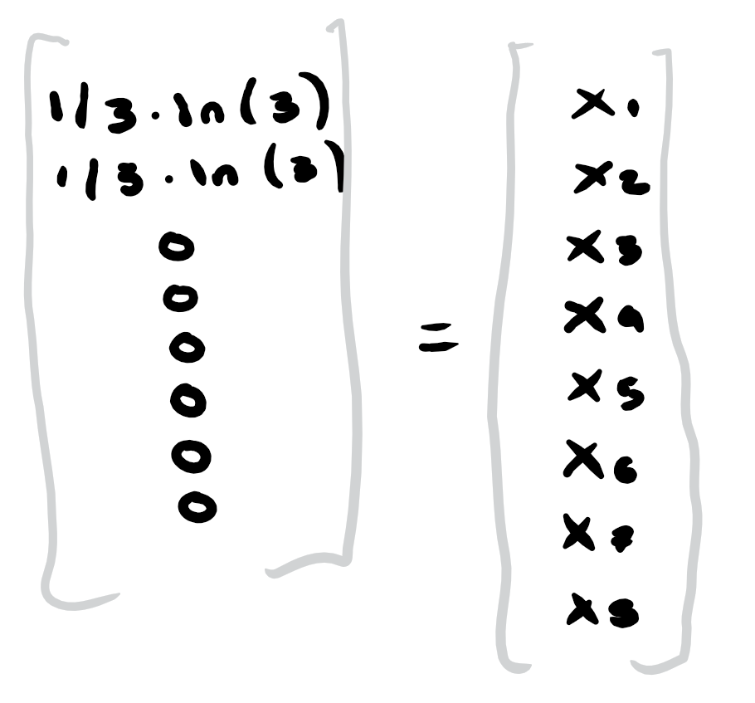
Bag of Words
We feed in “X” as a bag of words:
S1 = (1/3*ln(3/1), 1/3*ln(3/1), 1/3*ln(3/3), 0, 0, 0, 0, 0)

Slide 11
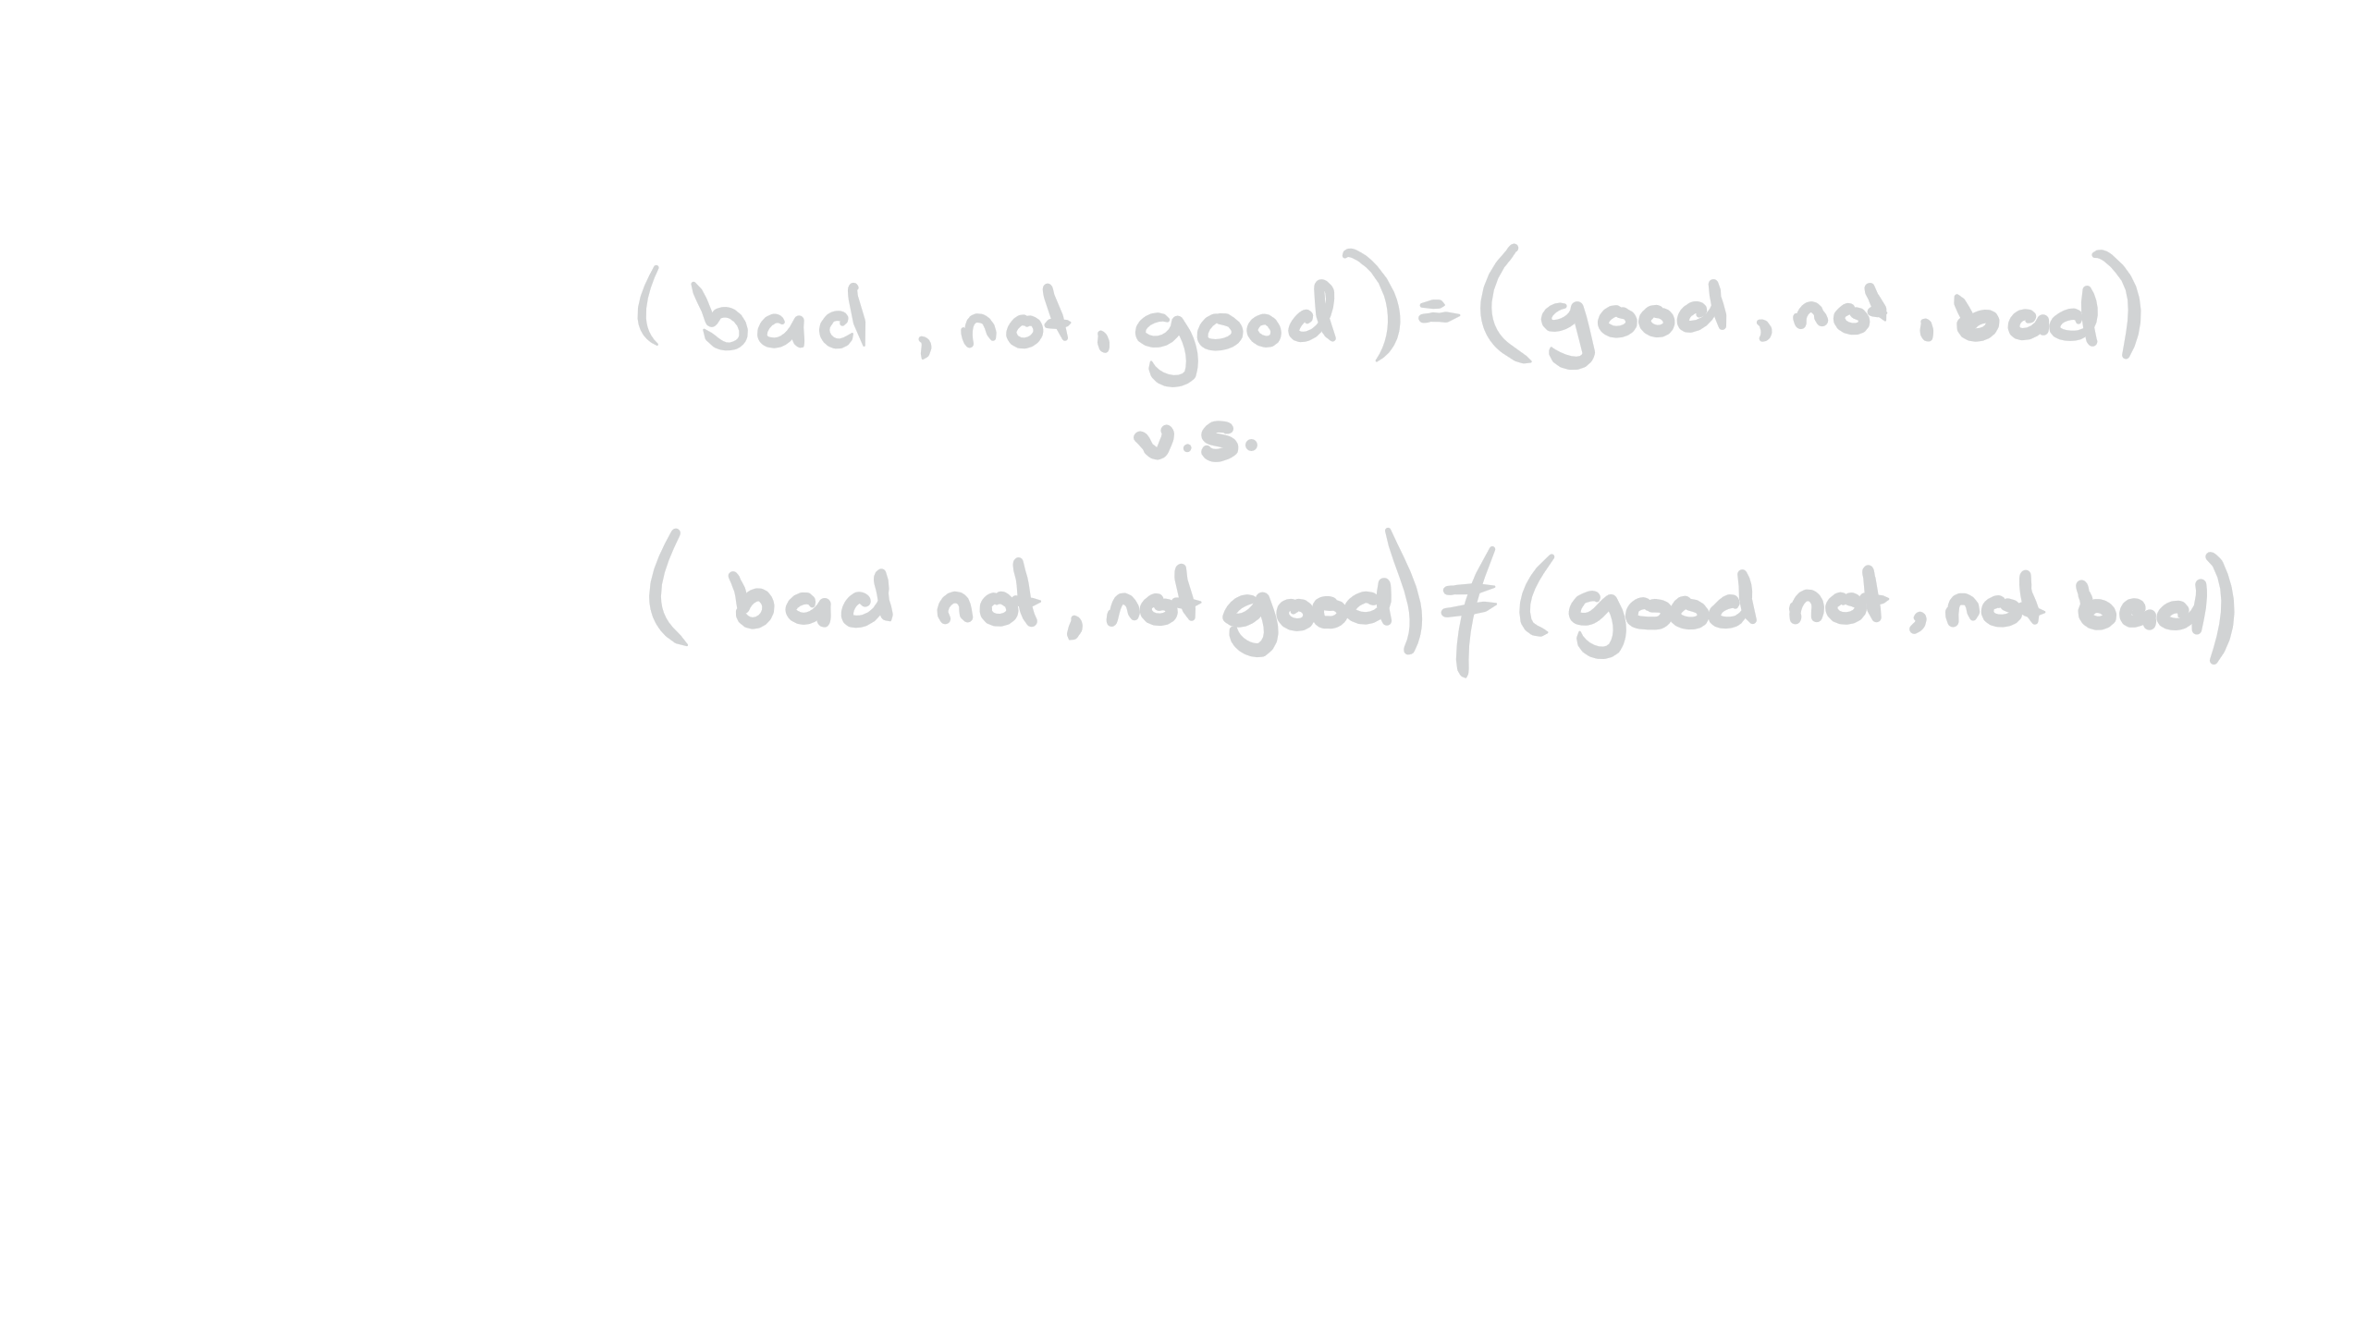
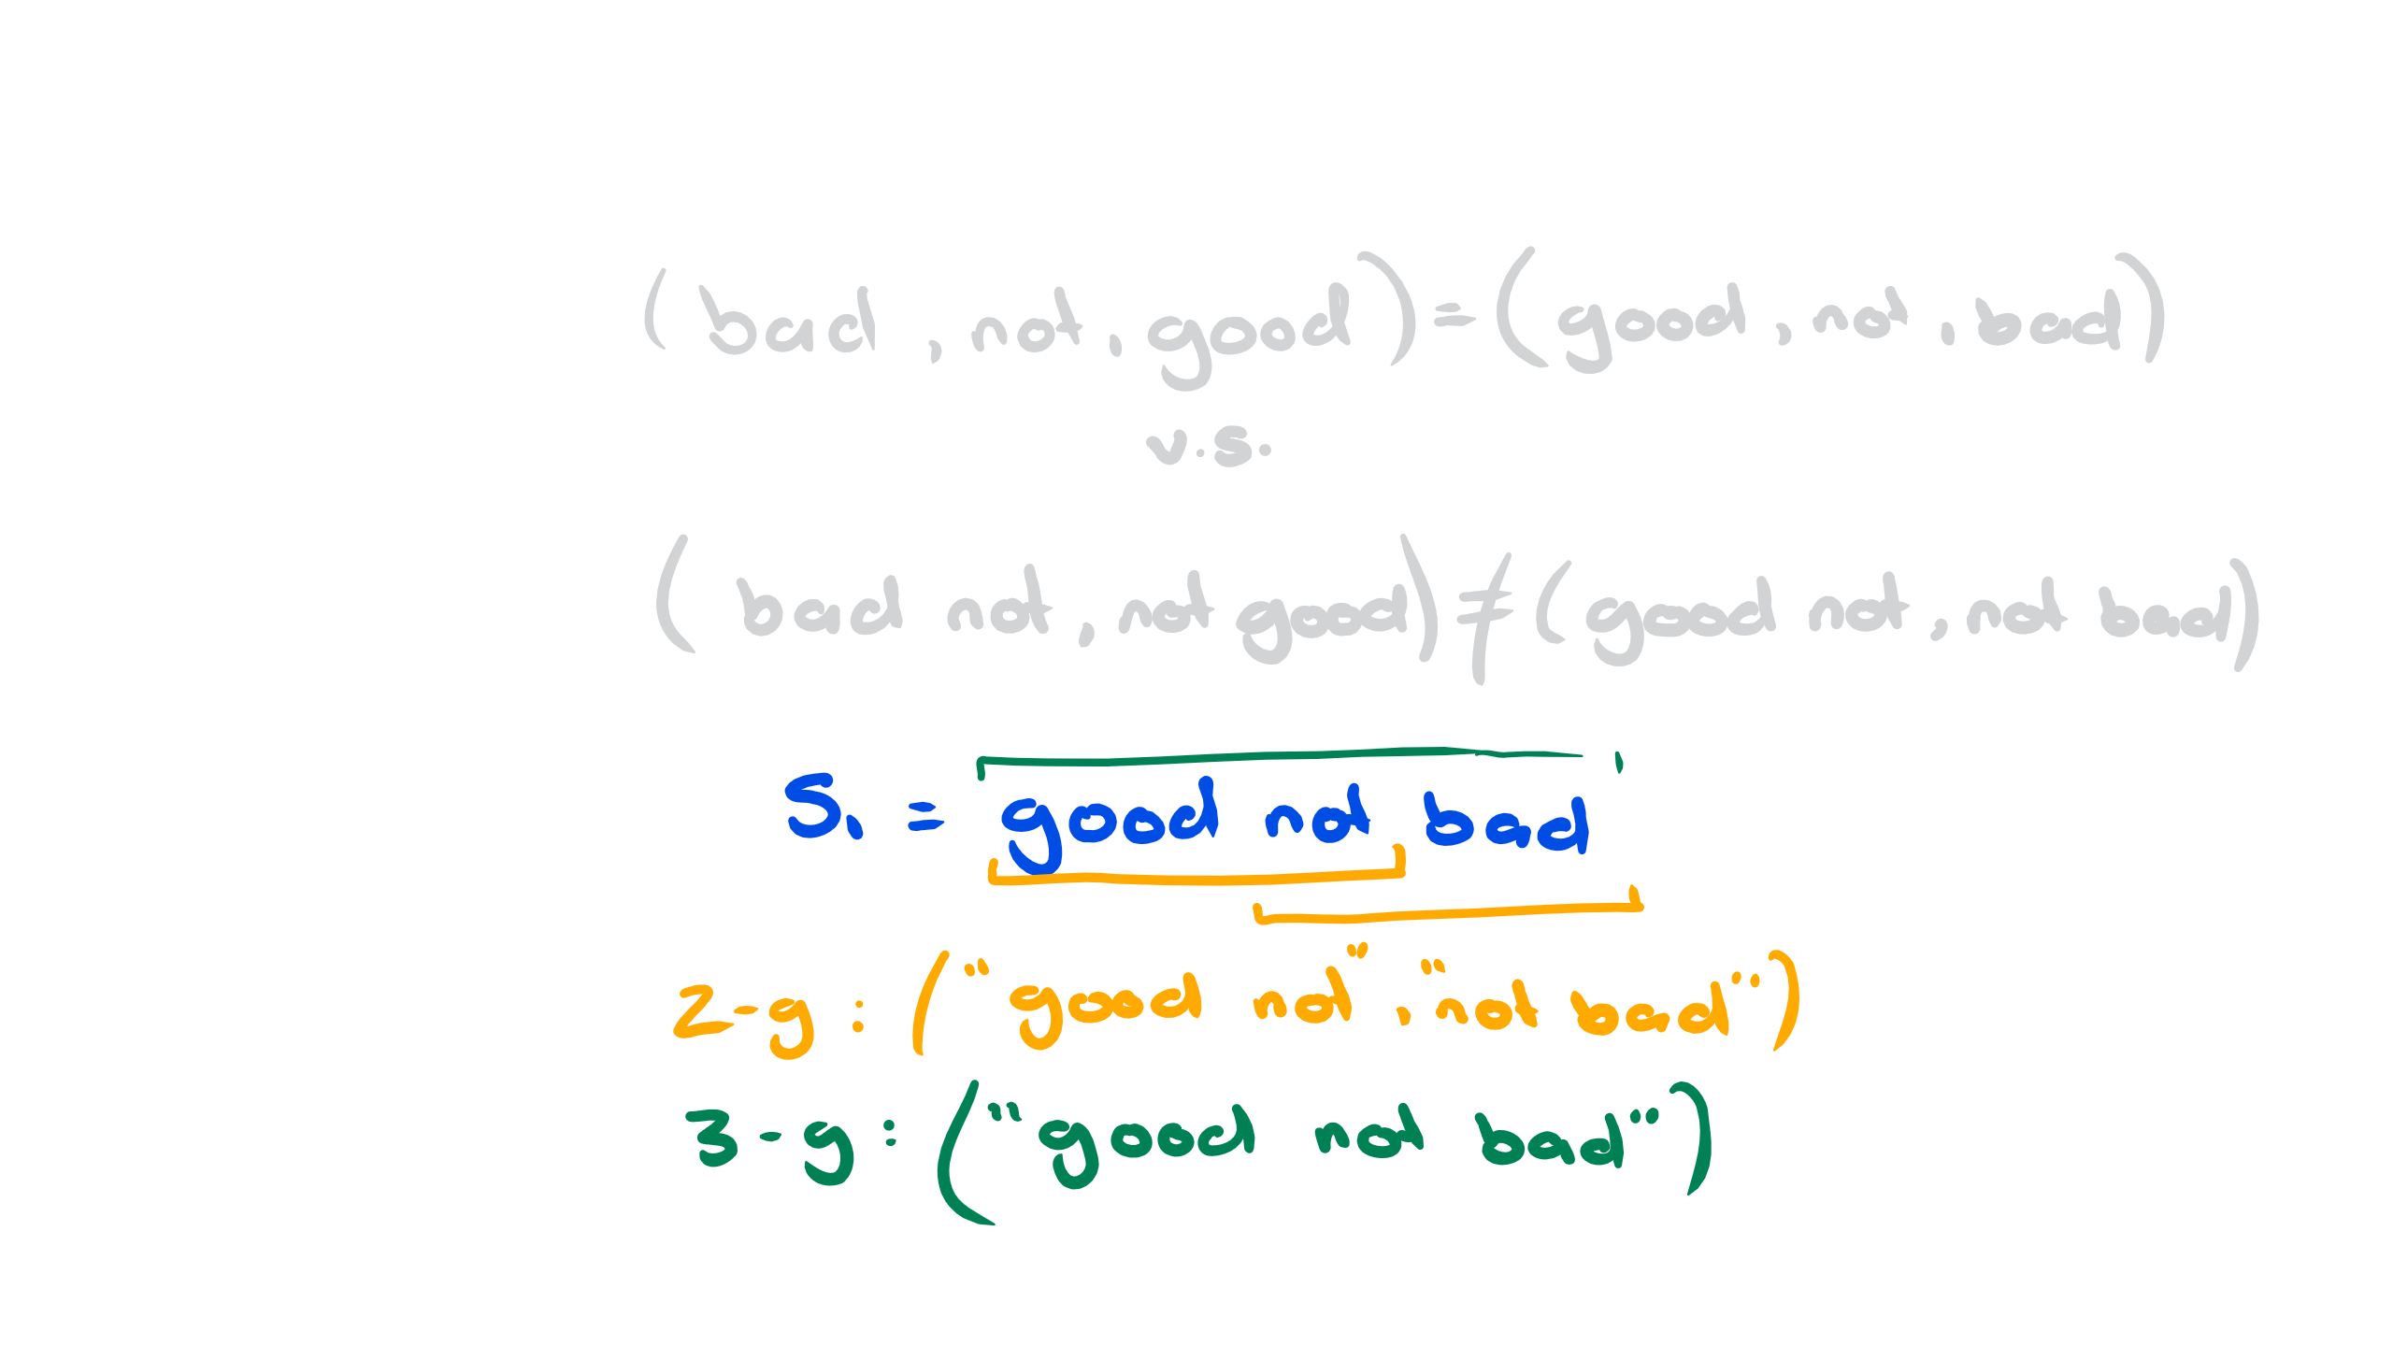
Bag of N-grams
An obvious issue with working at the “word-level” …
We input the (positive) sentence: “good, not bad”
The same as: “bad, not good”
N-grams is an approach to work on the n-word-level

Slide 12
Tfidf + n-grams on Amazon
Accuracy: 93%
What goes on behind the scenes?
Feature Importance
(Notice that high N-grams increase the features exponentially and suffer from sparsity)

Slide 13
“All happy families are alike; each unhappy family is unhappy in its own way.”
- “Anna Karenina” by Fyodor Dostoyevsky

Slide 14
According to Dostoevsky:
“This laptop is great”
“Book was nice”
“Dress was great”
“Very nice pen”
“Great read”
“This was not what I expected, wrong size”
“The book was too advanced at times and too simple in others”
“This comes with the old firmware which is not compatible”

Slide 15
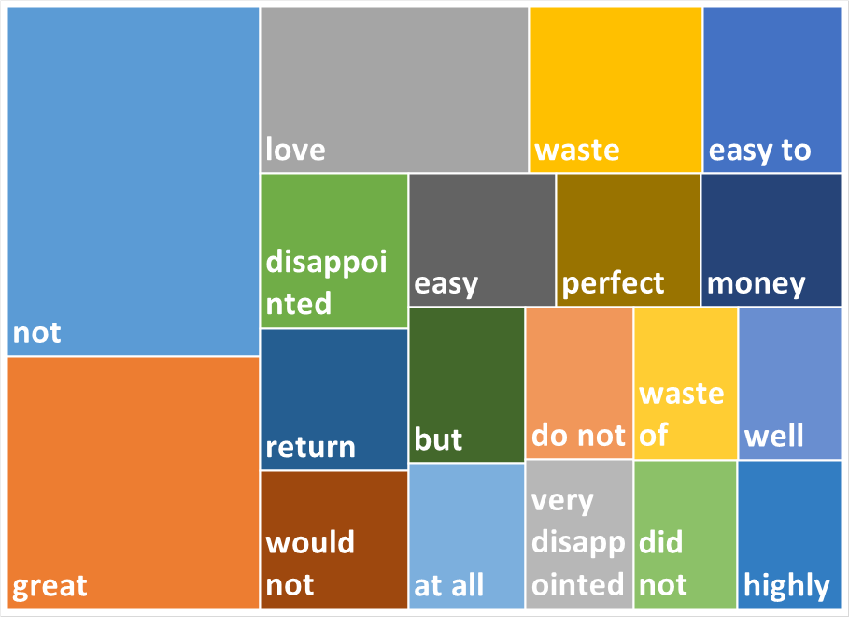
Feature Importance

Slide 16
What is Bag of Words missing?
Word relations (semantic meaning)
“Paris” is closer to “France” than to “nail”
“hippo” is closer to “animal” than to “laptop”
Word order (beyond n-grams)
“It would be a lie for me to say that this movie was not horrible”
“It would not be a lie for me to say that this movie was horrible”

Slide 17
2. Distributed Word Vectors

Slide 18
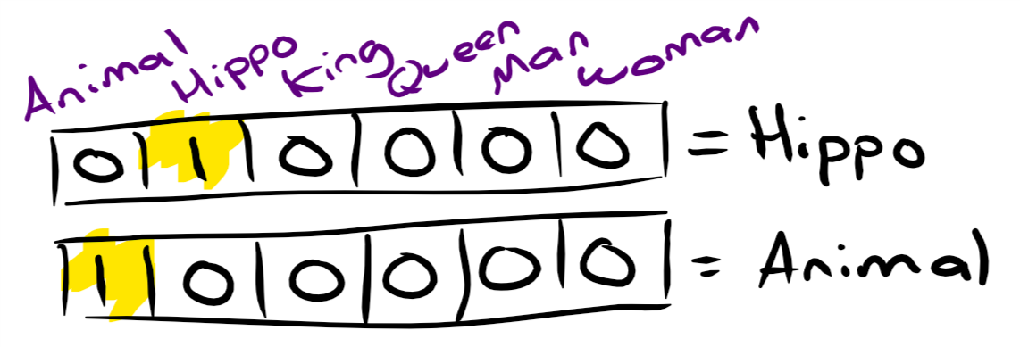
Simple Word Vectors
Vector of weights
Simplest case is a one-hot-vector
If English only had 6 words:

Slide 19
Word Vectors
No comparison is possible …
Hippo * Animal = 0 = Hippo * King
What if we could reduce the dimensions to something smaller than the vocab size
Previously the dimensions represented words, what would they represent now?
Can we represent 4 words with 2 dimensions instead of 4?

Slide 20
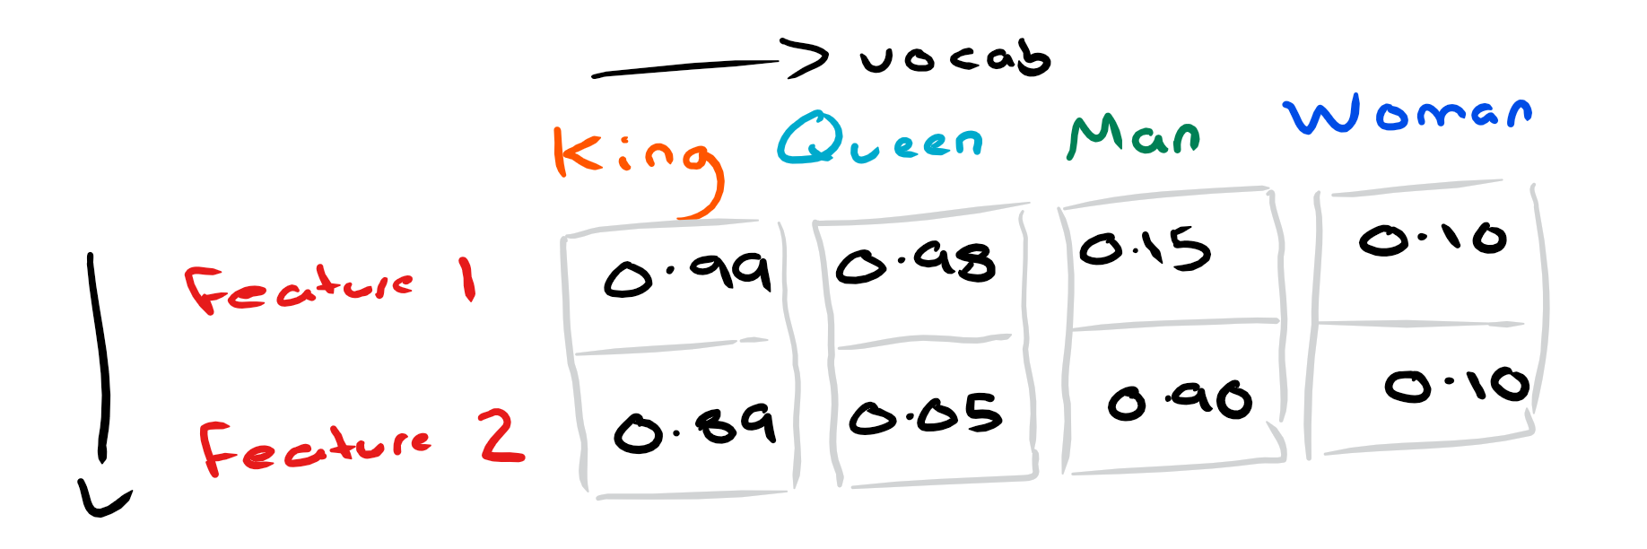
Distributed Word Vectors
Instead of one-hot-vectors, we take a little from each category -> distribute weights across dimensions

Slide 21
“I express not the word for the word but the sense for the sense..”
- “Is that a Fish in your Ear?” by David Bellos

Slide 22
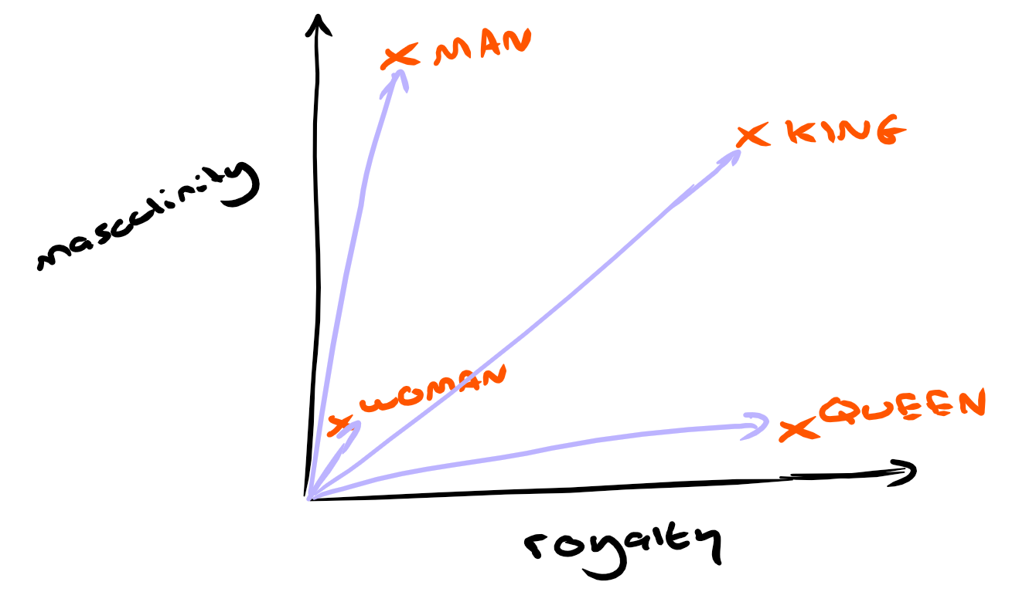
Something interesting happens …
Now the vectors represent an abstract meaning of a word
Perhaps the features are something like “royalty” and “masculinity”?

Slide 23
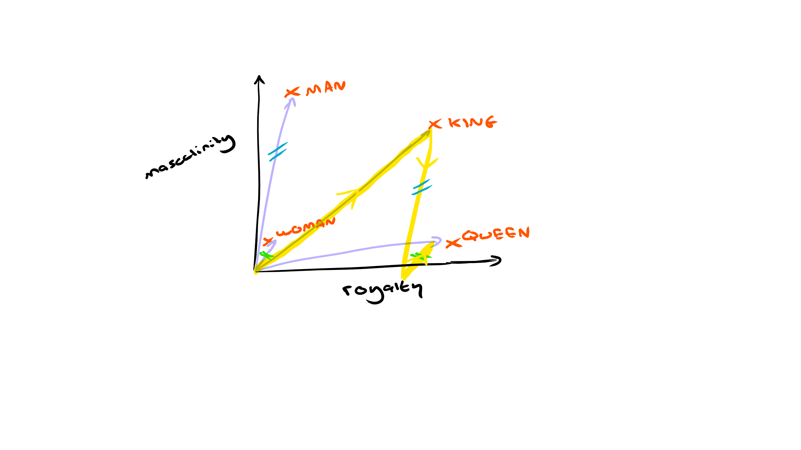
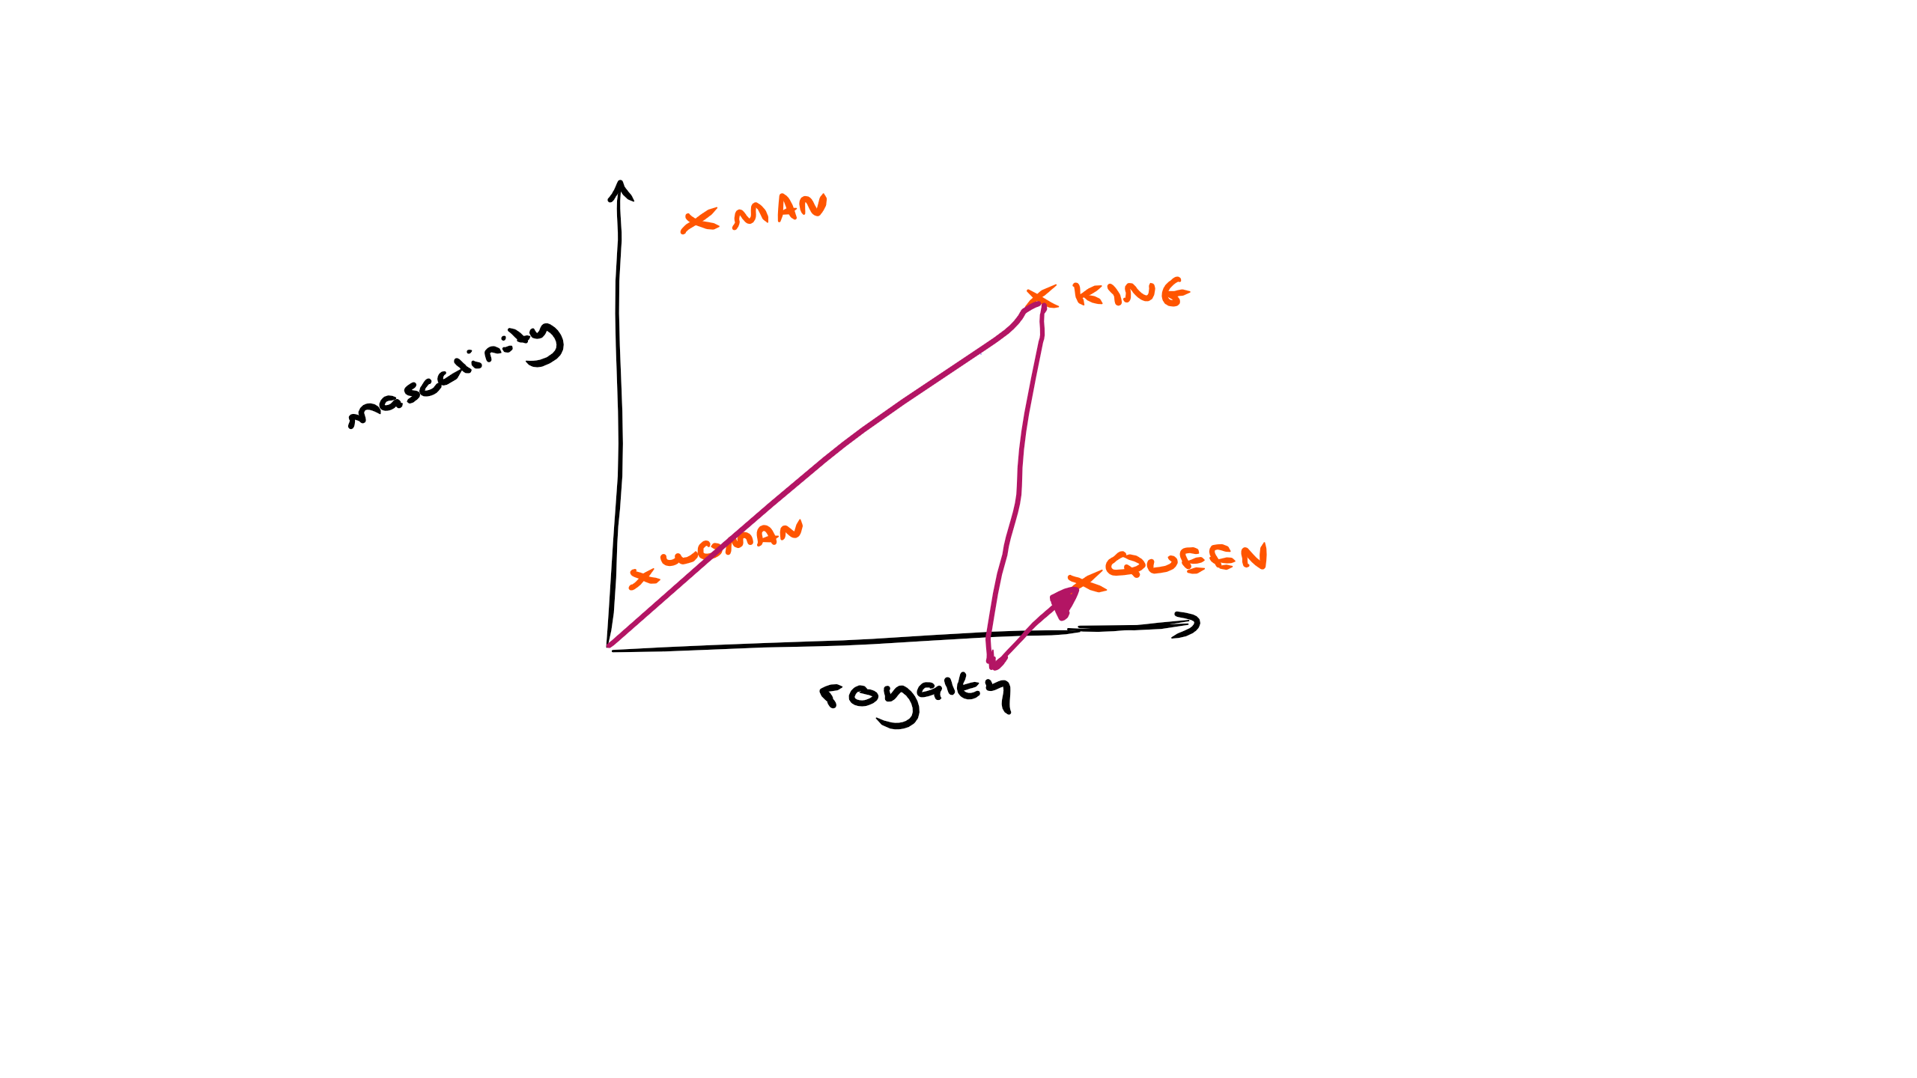
Vector Addition
We can get results like this: king – man + woman = queen

Slide 24
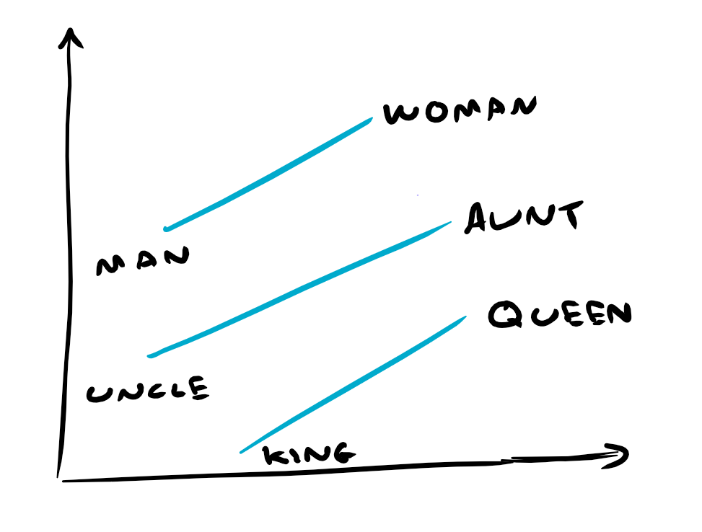
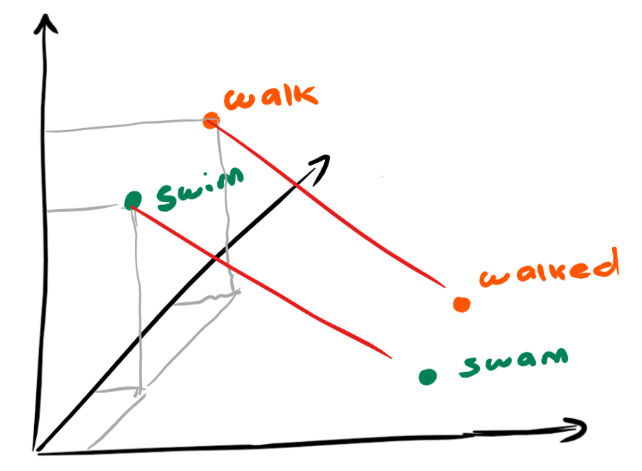
Vector Offsets
Relationships emerge (male/female, verb tense, etc.)

Slide 25
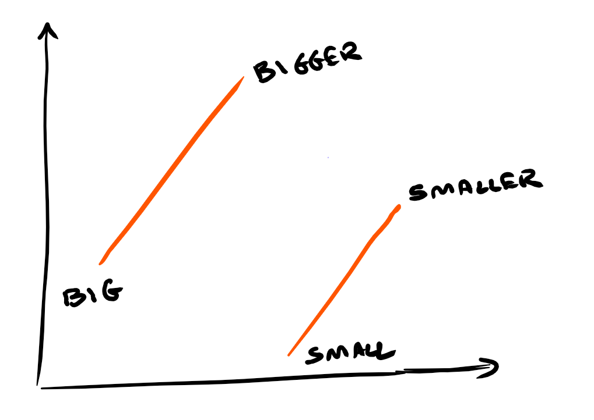
Vector Offsets
“France” is to “Paris” as “Italy” is to ? “Rome”
“Big” is “bigger” as “small” is to ? (“smaller”)

Slide 26
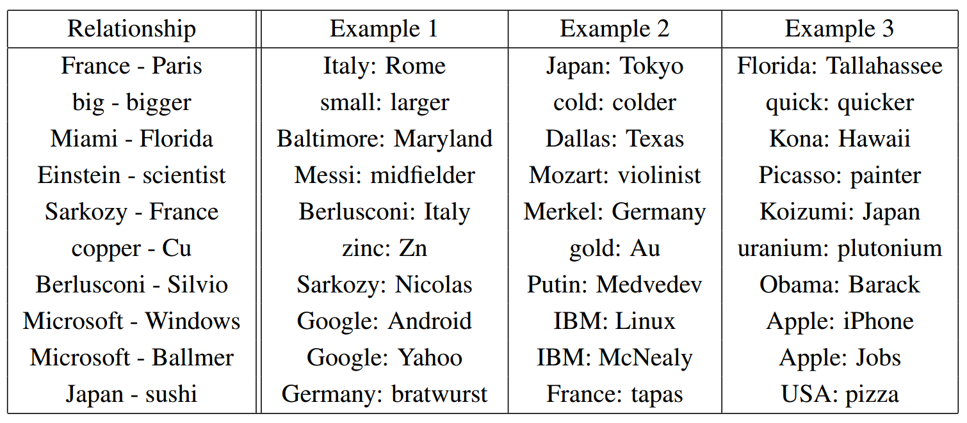
Examples of Word Pair Relationships
Table 8 - Mikolov et al. – “Efficient Estimation of Word Representations in Vector Space”

Slide 27
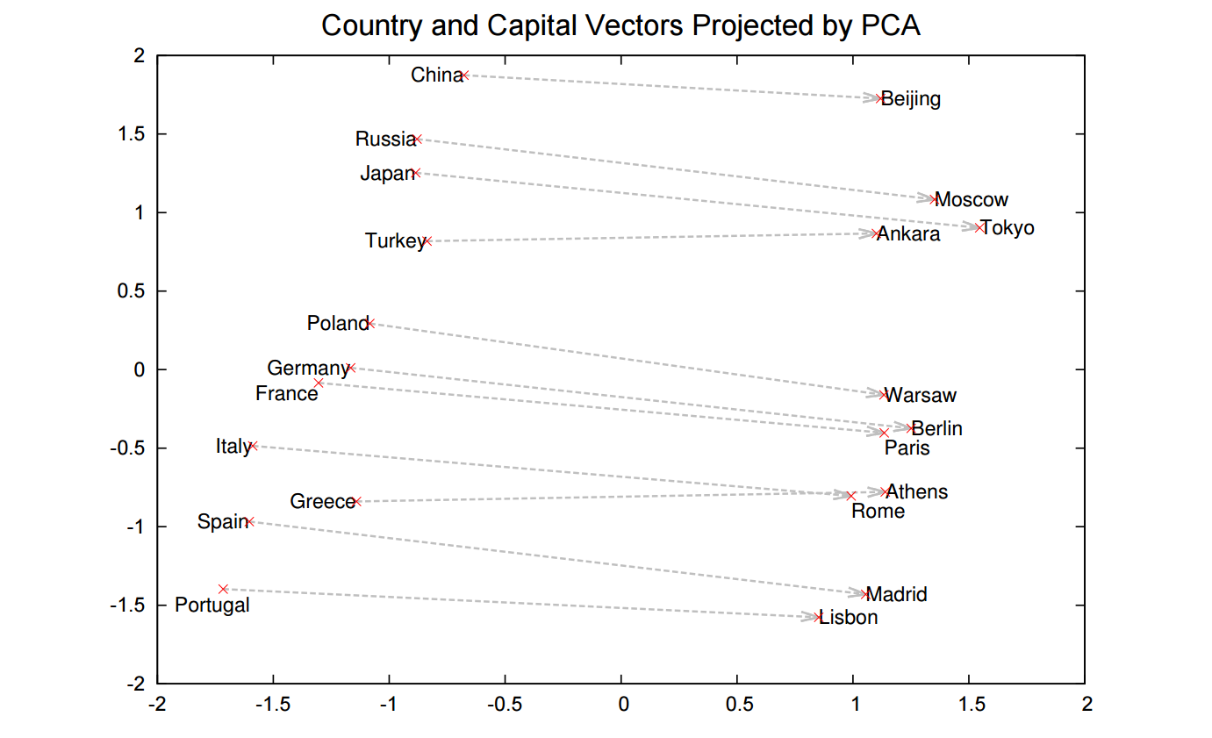
Country and Capital Vector Projections
Figure 2 - Mikolov et al. – “Distributed Representations of Words and Phrases and their Compositionality”

Slide 28
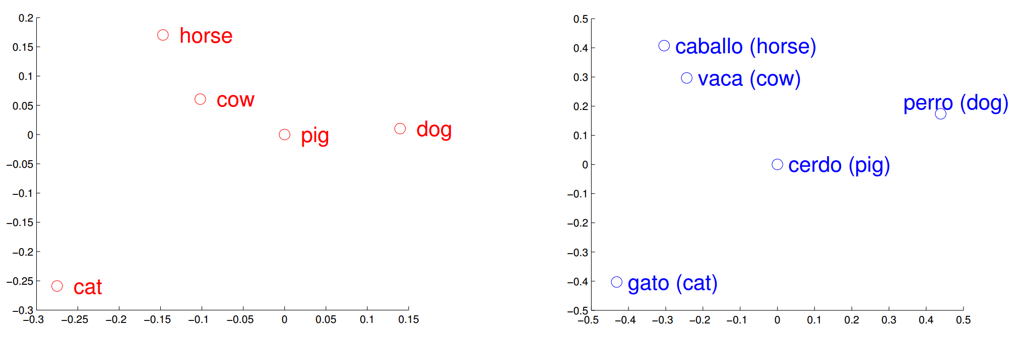
Translation possibilities
Figure 1 - Mikolov, Tomas, Le, Quoc V., and Sutskever, Ilya – “Exploiting similarities among languages for machine translation”

Slide 29
Information Sharing
Q: “Do you like meat?”
A: “No.”
Q: “Do you like chicken?”
A: “No.”
Q: “Do you like lamb?”
A: “No.”

Slide 30
Information Sharing
With fewer dimensions a vector ends up representing a lot more!
All of these relationships between vectors allow the sharing of knowledge
If the model learns that “movies” are bad, it will also understand that “Star Wars” is bad
How do we get these word vectors? Two popular methods: Glove and Word2Vec

Slide 31
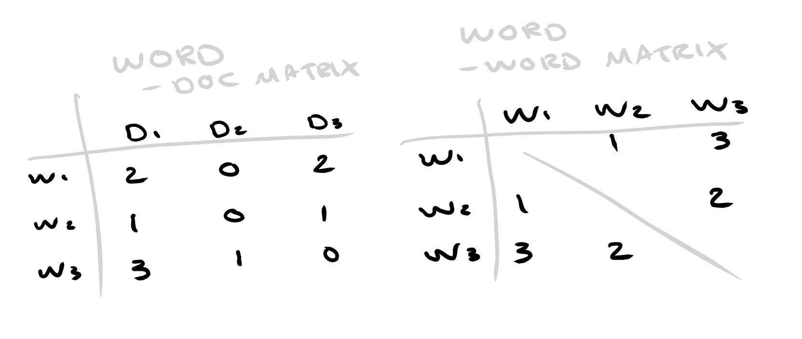
1 - Co-occurrence Matrix (Glove)
We can accumulate (global) word co-occurrences in some matrix and then split that into vectors

Slide 32
2 – Sliding Context Window (Word2Vec)
Instead of performing calculations on a huge matrix …
Iteratively progress, taking a window of words at a time
Words which occur in a similar context will end up closer together
Assumes distributional hypothesis:
Words characterised by words they hang out with -> p(w | ”Cinderella”)?

Slide 33
Word2Vec

Slide 34
Word2Vec
Greatly reduced the computational complexity compared to previous methods
It’s not one algorithm but a bag of “tools”:
Continuous Bag of Words
Skip-Gram
Hierarchical Softmax

Slide 35
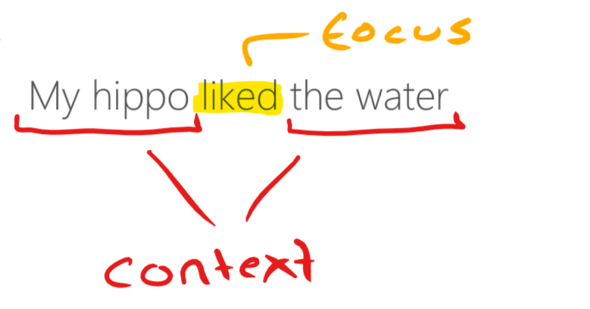
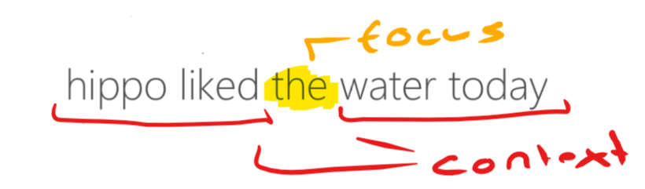
Continuous Bag of Words
We want to predict a focus word given a context
“My hippo liked the water today”
If we have a window of +/- 2 words:

Slide 36
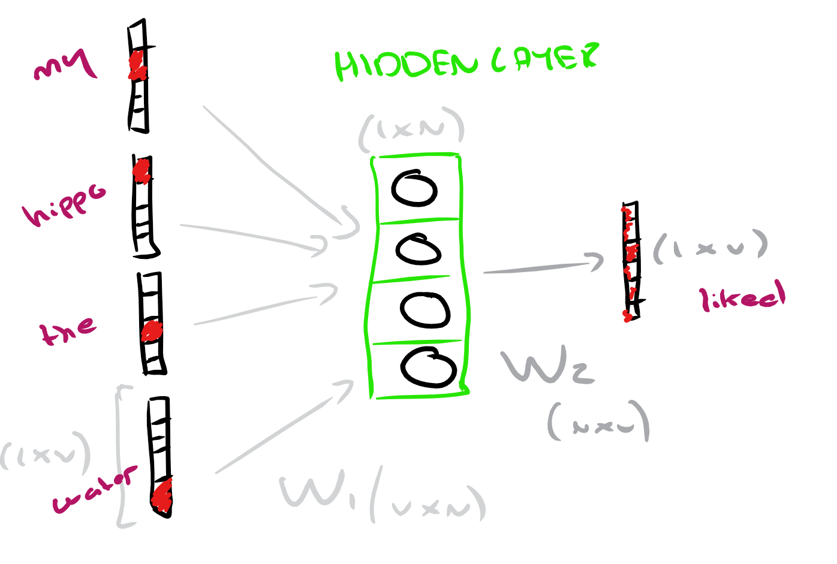
Continuous Bag of Words
A shallow neural network
Vocab of size V & N amount of features

Slide 37
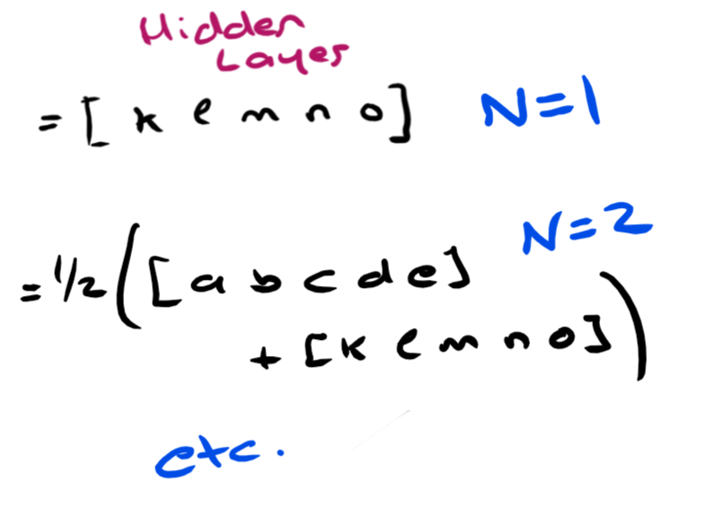
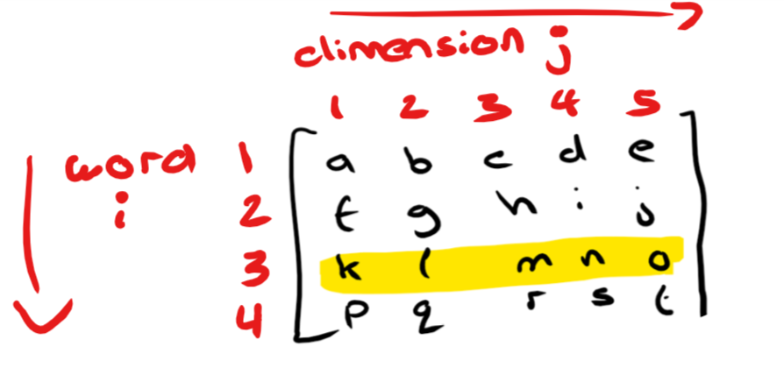
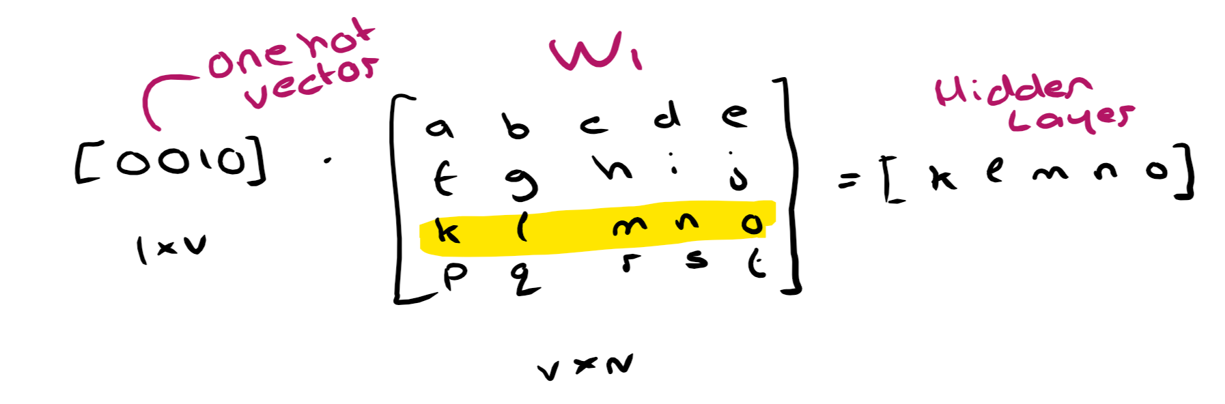
Continuous Bag of Words
Aim: maximise conditional probability of observing the focus word given the context
The model learns two (weight) matrices: W1 and W2

Slide 38
Continuous Bag of Words
If we have more than one word (C words) then we simply end up taking the average:
1/C[w1 + w2 + … + wc]
Linear! Not deep learning!
So the model extracts something from the context words (creates word vectors) to predict the focus
Thus words in similar contexts will have similar vectors

Slide 39
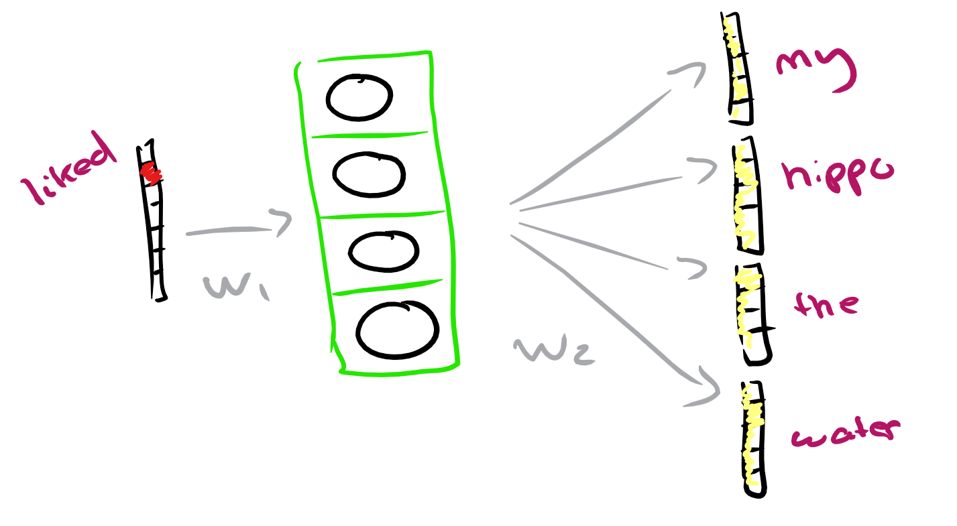
Skip-Gram
We want to predict the context given a focus word
Technically we predict C multinomial distributions to minimise the sum of the prediction error across all context words

Slide 40
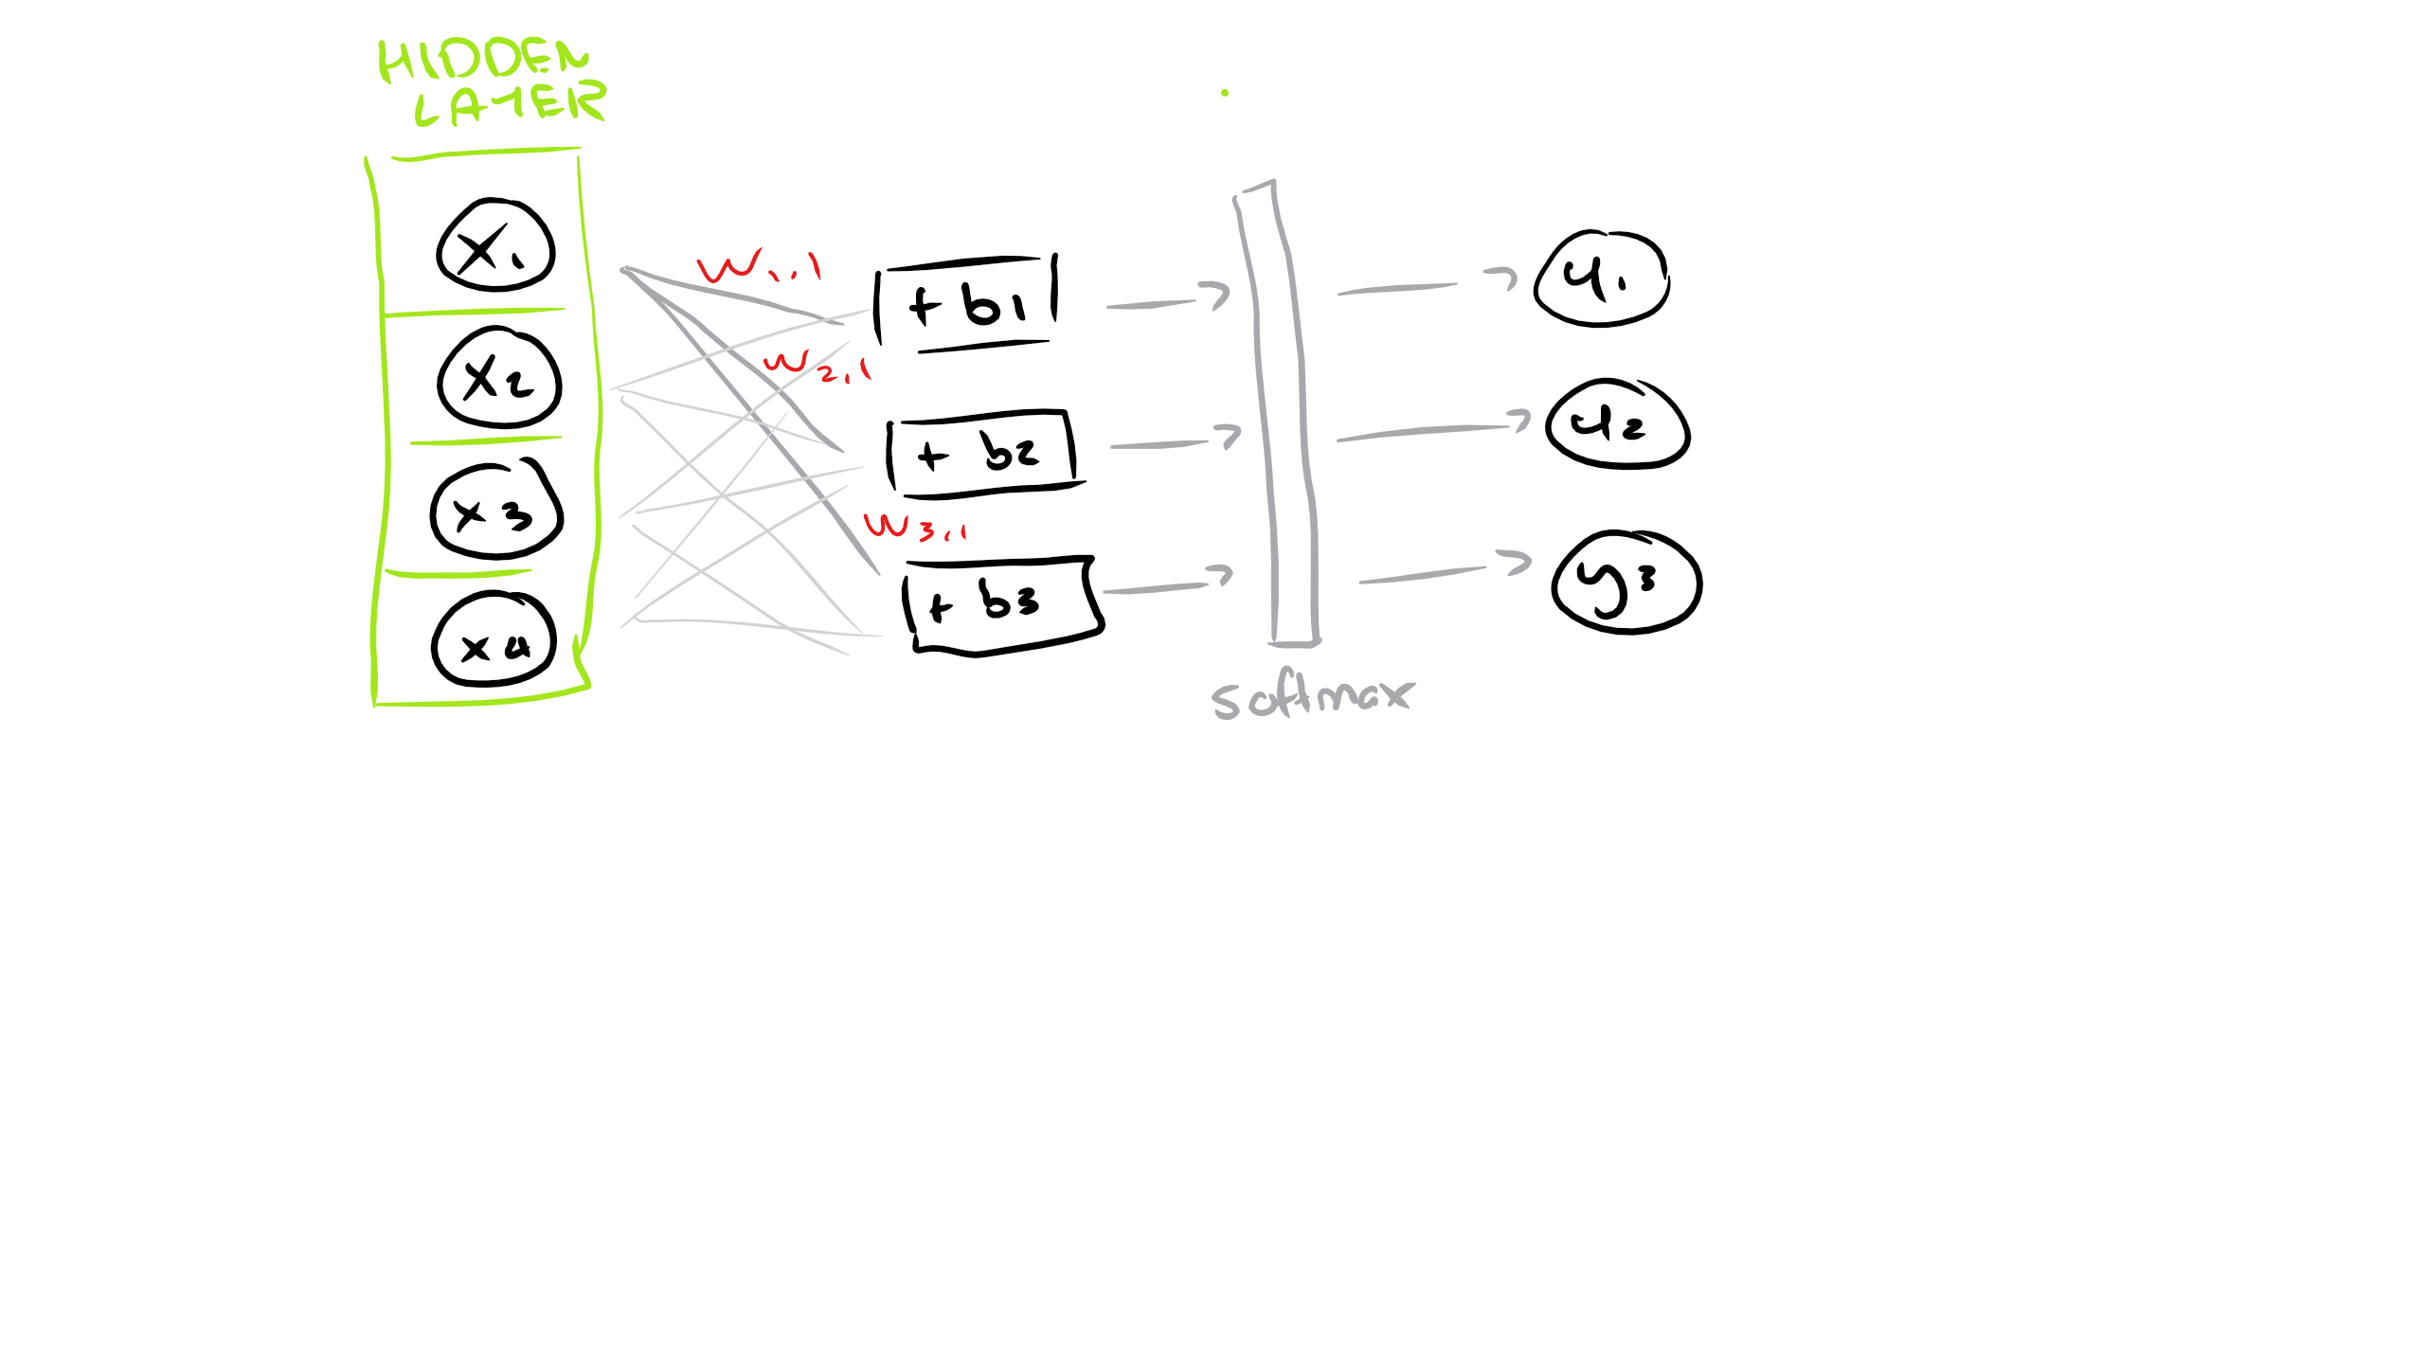
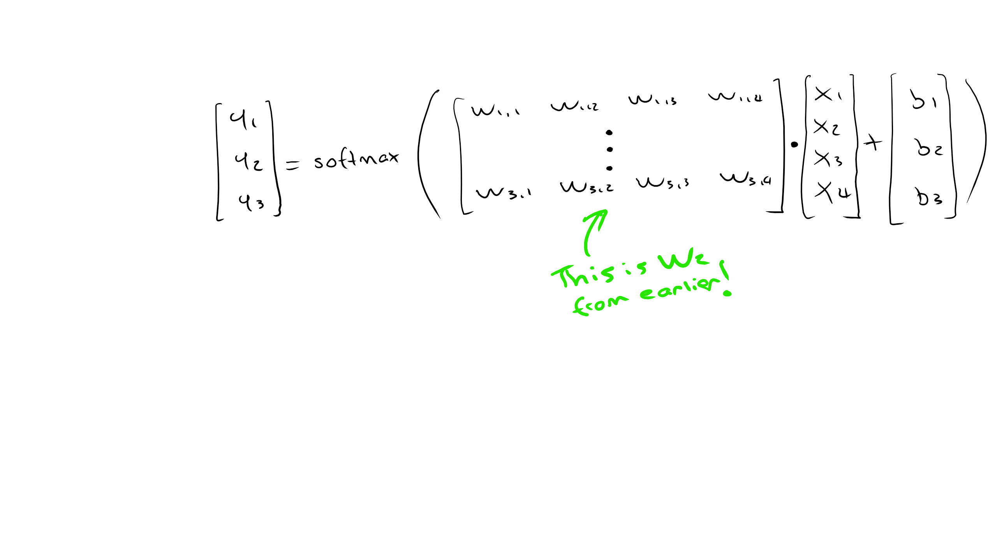
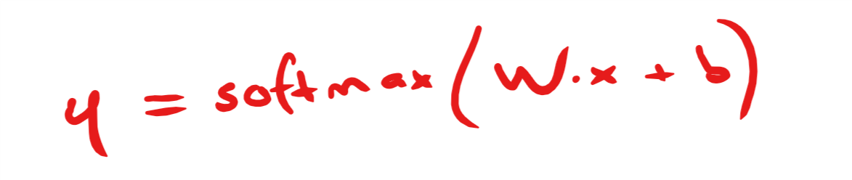
Hierarchical Softmax
A traditional softmax output layer (compute scores that sum to 1 for each possible output)

Slide 41
Hierarchical Softmax
With the traditional approach we need to evaluate all V output nodes
It’s very costly to update the weights of this matrix for every word in our corpus!
We want the limit the number of output nodes that must be updated per training
We can create a tree structure to help with this

Slide 42
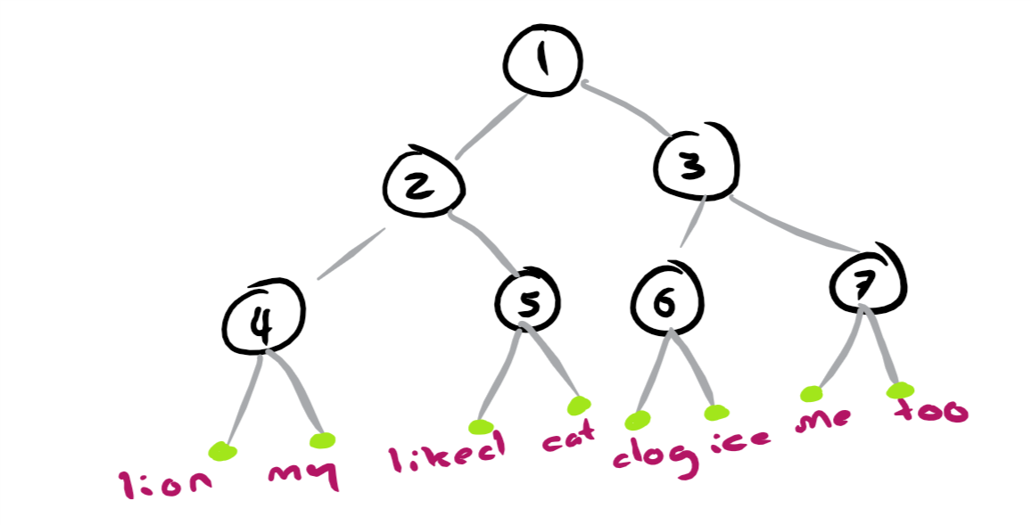
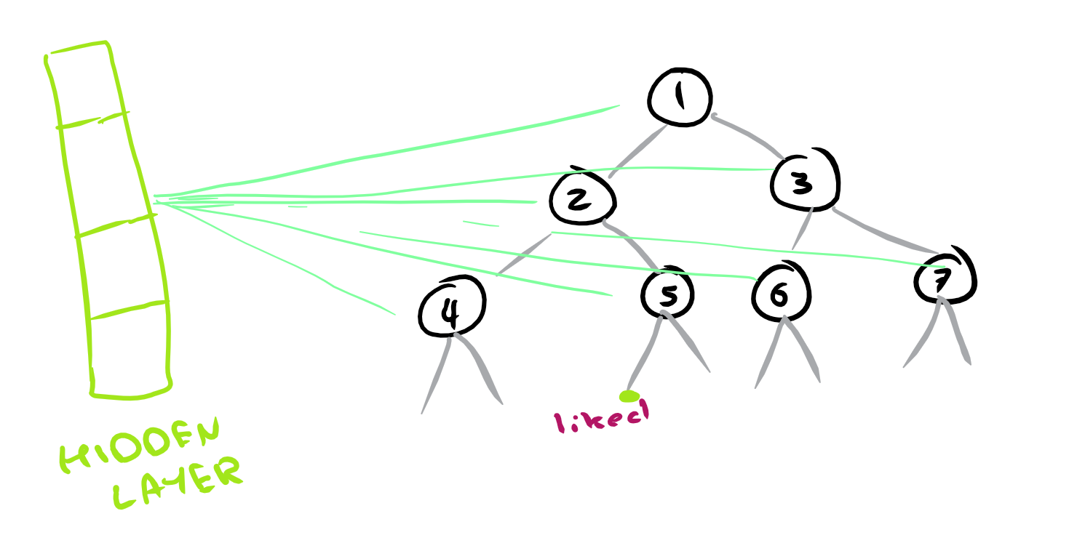
Huffman Tree
The leaves of the tree represent our words

Slide 43
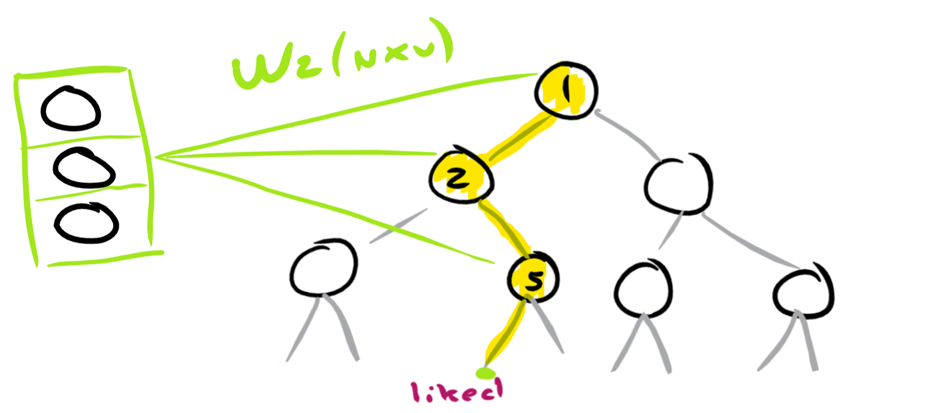
Huffman Tree
We now only need to evaluate some nodes to get the probability distribution
p(“liked” | context) = p(left at 1 | context) * p(right at 2 | context) * p(left at 5 | context)

Slide 44
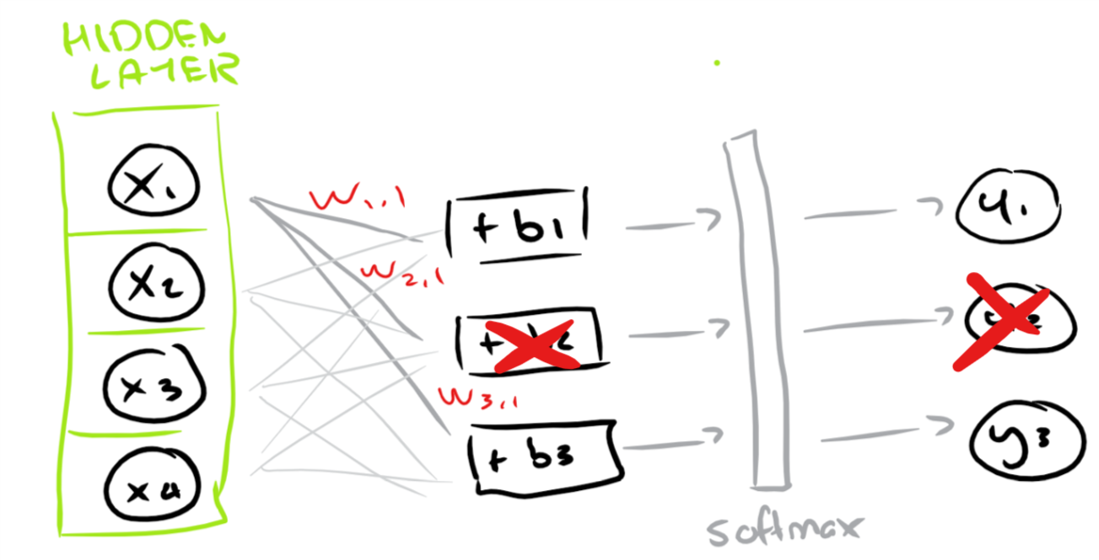
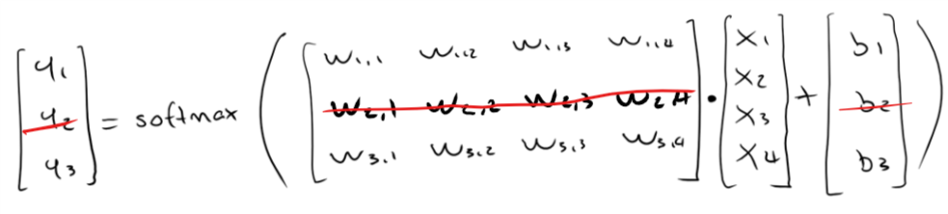
Huffman Tree
This means we only need to compute the weights going to y1 and y3 below (for example):

Slide 45
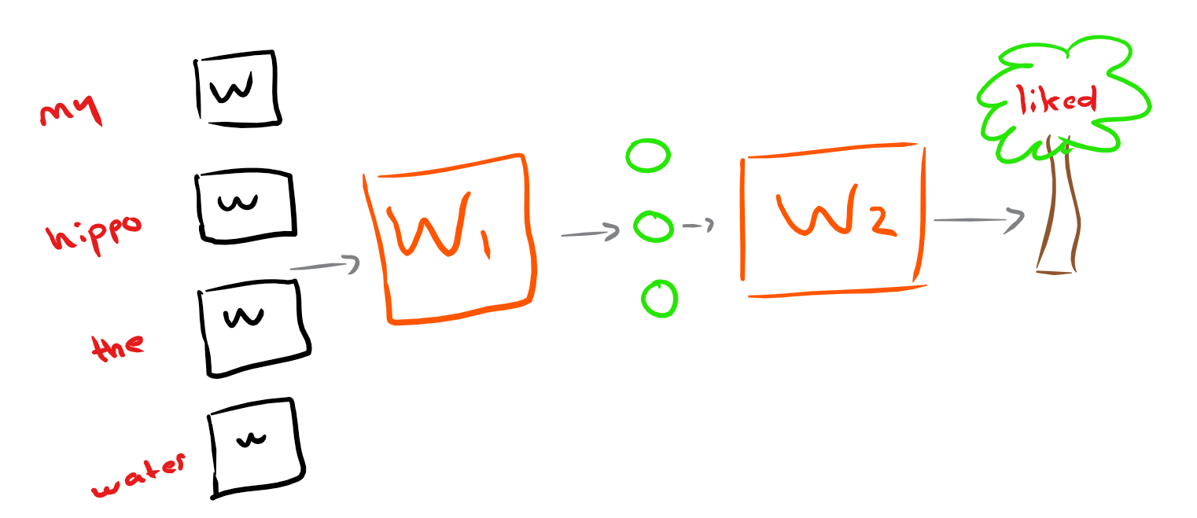
Tying Everything Together …
We iteratively adjust the weights in our two matrices to better predict a missing word => get word vectors (W1)

Slide 46
Word2Vec on Amazon Reviews

Slide 47
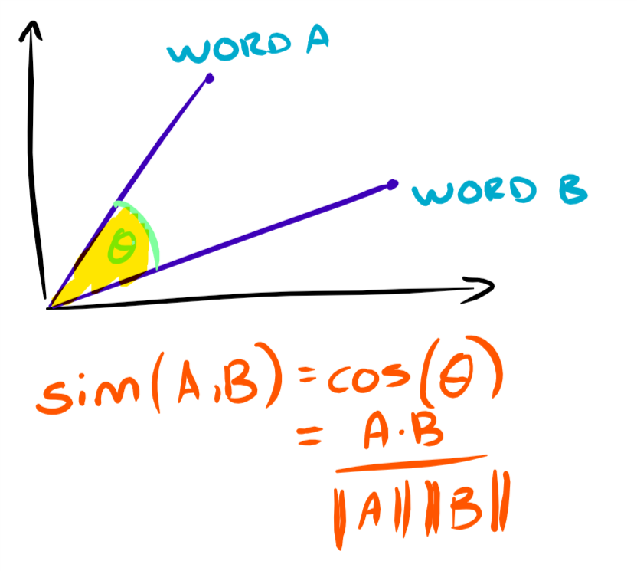
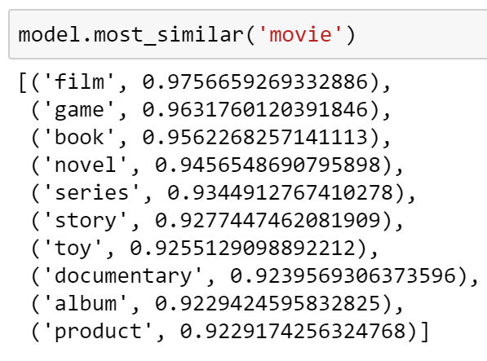
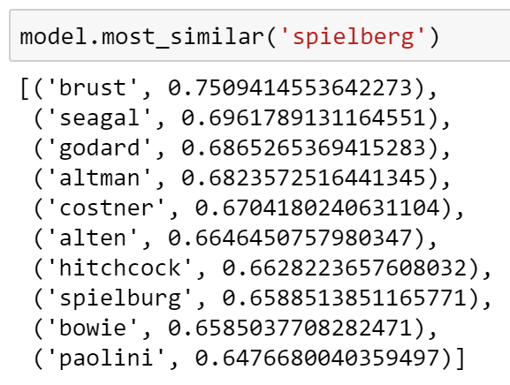
Some Interesting Results
We can play around with the cosine similarity:

Slide 48
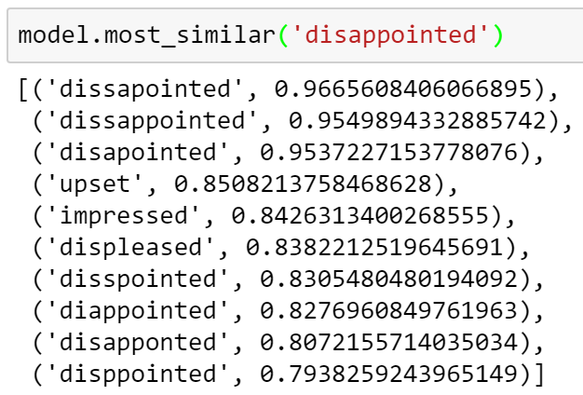
Some Interesting Results
We even capture spelling mistakes!

Slide 49
Bag of Word Vectors
All of our inputs (X) need to be the same shape but documents have varying amounts of words
How do we represent our reviews with the word vectors?
I averaged the word vectors (why does this work? … king + woman – man = ?)
Accuracy of 84%
Bag of Words to Bag of Word Vectors – we have word relations but not word order

Slide 50
3. Paragraph Vectors

Slide 51
Paragraph Vectors
Previous methods of ‘grouping’ word vectors have set-backs:
Word vector (weighted) averaging loses word order
Combining word vectors in an order given by a parse tree of a sentence hard to generalise beyond sentences

Slide 52
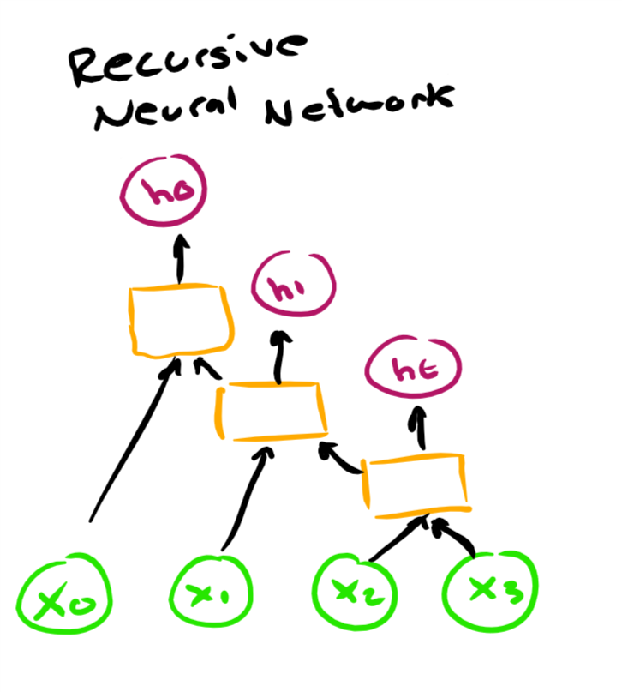
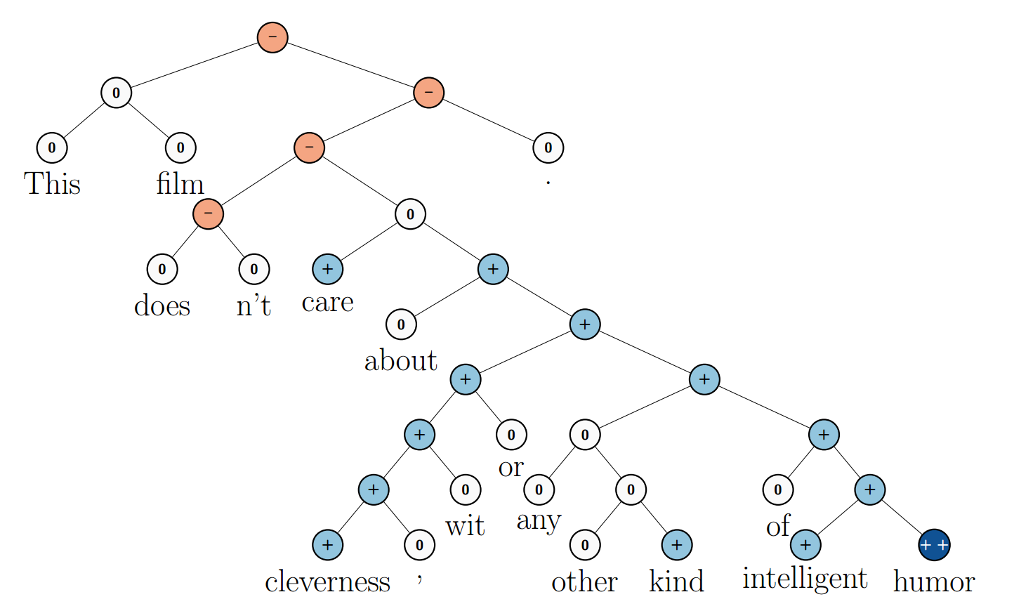
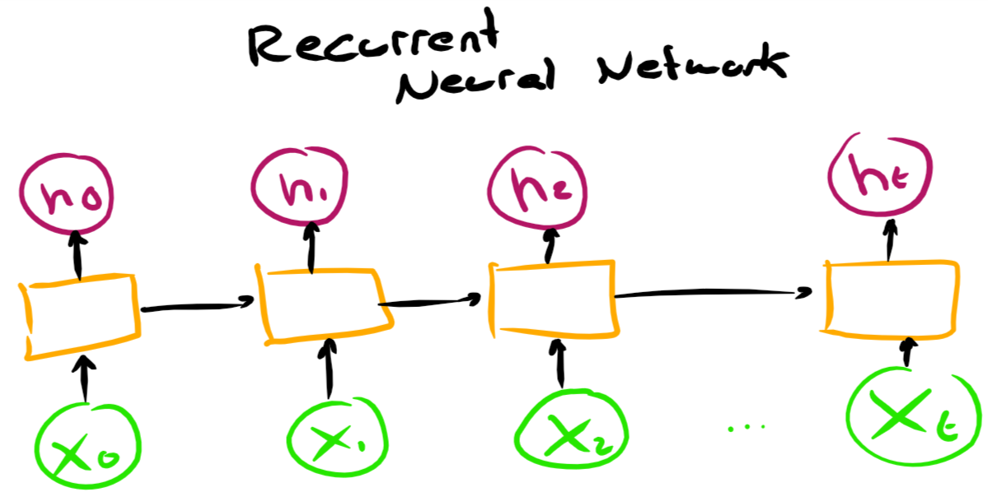
(Recursive Neural Network - Parse Tree)
Figure 1 - Socher et al. – “Recursive Deep Models for Semantic Compositionality Over a Sentiment Treebank”

Slide 53
Paragraph Vectors
Doc2Vec acts as a wrapper around Word2Vec
Approach: concatenate paragraph vector with several word vectors -> predict following word
Paragraph vectors unique among paragraphs
Word vectors shared among paragraphs
Prediction -> word vectors fixed and paragraph vector inferred

Slide 54
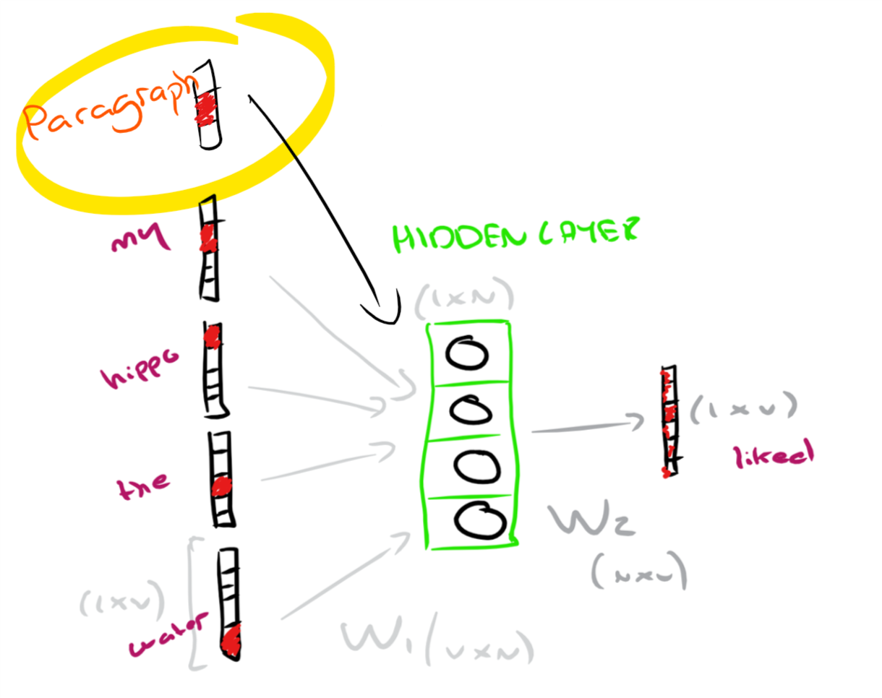
Distributed Memory … tada …

Slide 55
Doc2Vec on Amazon Reviews

Slide 56
Some Interesting Results
86% accuracy using the derived paragraph vectors
Just like with word-vectors we can measure the similarity across document vectors we have trained on:
“it is and does exactly what the description said it would be and would do . couldn ' t be happier with it .”
Most similar to:
“very compact and easy to use . does what they said it would do . i would recommend it to a friend .”

Slide 57
Some Interesting Results
We can also infer document vectors for new phrases and see what they are similar to
I can feed in:
“this broke straight out of the box”
And get back:
“this did not work .”

Slide 58
Evaluation

Slide 59
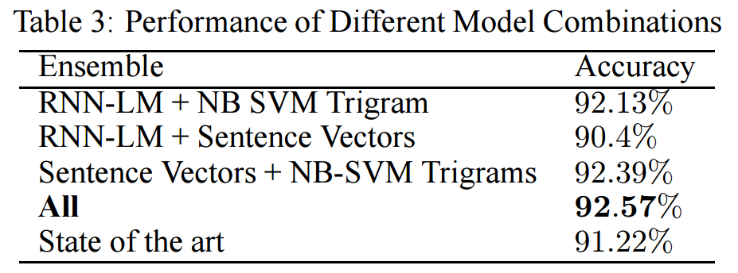

IMDB Data
In the 2015 Paper “Ensemble of Generative and Discriminative Techniques for Sentiment Analysis of Movie Reviews”:

Slide 60


Amazon Data
My results were very similar:

Slide 61
Why?
Not a criticism on distributed word vectors - perhaps people just don’t leave complicated reviews:
“I would be lying if I did not say that the experience this movie bestowed on me was neither a sting by a bee nor a trip to the inferno”
Or:
“Yeah, it was good”
Perhaps the “information sharing” from distributed vectors links synonyms and antonyms too closely for a classifier to separate them

Slide 62

Why
Remember:
Imagine the case if:

Slide 63

Why

Slide 64


Synonyms & Antonyms

Slide 65
Behind the Scenes (Cortana Intelligence Suite)

Slide 66




Lots of Data, Lots of Features - HDInsight

Slide 67
Very fast blob storage (and transfer)
cd “C:\Program Files (x86)\Microsoft SDKs\Azure\AzCopy”
AzCopy /Source:C:\myfolder /Dest:https://myaccount.blob.core.windows.net/mycontainer /DestKey:key /Pattern:"abc.txt"

Slide 68

PySpark – SQL Queries in Jupyter

Slide 69

PySpark – SQL Queries in Jupyter

Slide 70

PySpark UDFs – Clean Data

Slide 71
PySpark Filtering – Prepare Data

Slide 72

Training – Features Step 1

Slide 73

Training - Features Step 2

Slide 74

Training – Features Step 3

Slide 75

Training – Features Step 4

Slide 76

Training – Features Step 5

Slide 77
Training - Classifier

Slide 78

Test Data - Features

Slide 79
Test Data - Prediction

Slide 80
Comments
N-gram and log transformation boosted accuracy from 66 to 89%

